Slide 1
Common Causes & Solutions for Compressed Air Pressure Drop
Tom Taranto, Data Power Services
Keynote Speaker
Sponsored by
The recording and slides of this webinar will be made available to attendees via email later today.
PDH Certificates will be e-mailed to attendees on within 2 days.

Slide 2
Q&A Format
Panelists will answer your questions during the Q&A session at the end of the Webinar.
Please post your questions in the Questions Window in your GoToWebinar interface.
Direct all questions to Compressed Air Best Practices® Magazine
Sponsored by

Slide 3
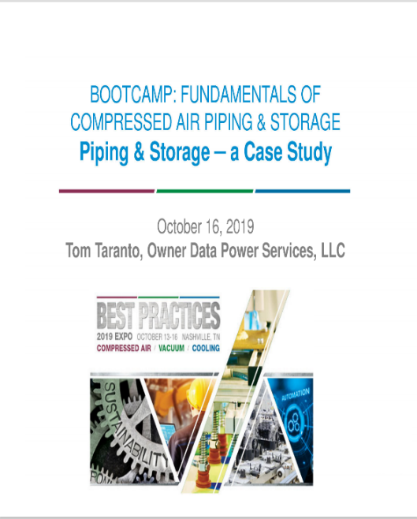
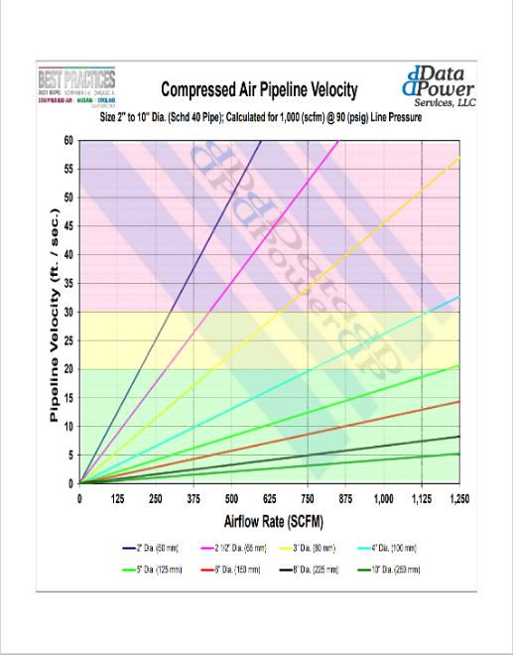
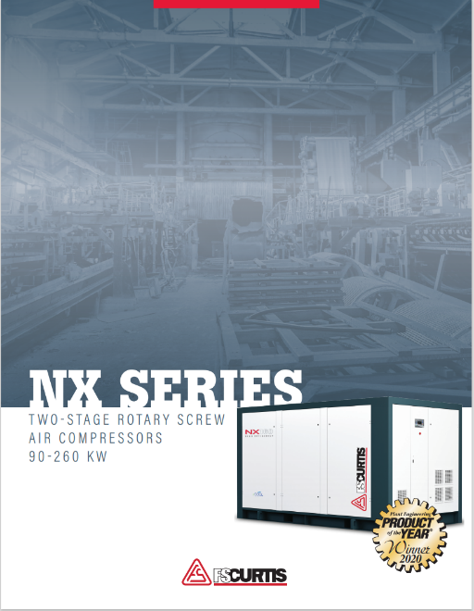
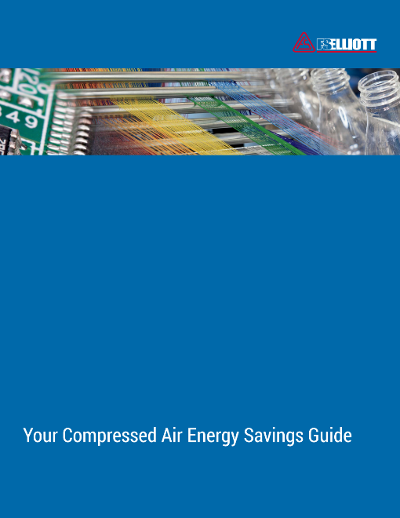
Handouts

Slide 4
Disclaimer
All rights are reserved. The contents of this publication may not be reproduced in whole or in part without consent of Smith Onandia Communications LLC. Smith Onandia Communications LLC does not assume and hereby disclaims any liability to any person for any loss or damage caused by errors or omissions in the material contained herein, regardless of whether such errors result from negligence, accident, or any other cause whatsoever.
All materials presented are educational. Each system is unique and must be evaluated on its own merits.

Slide 5
Common Causes & Solutions for Compressed Air Pressure Drop
Introduction
Compressed Air Best Practices® Magazine
Sponsored by

Slide 6
About the Speaker
Owner, Data Power Services
Over 45 years of experience in the compressed air industry
U.S. DOE Energy Expert, Compressed Air Challenge technical committee member, Compressed Air Challenge qualified instructor and instructor for Qualified AIRMaster+ Specialist Training
Tom Taranto
Data Power Services
Sponsored by

Slide 7
Root cause of pressure loss? Friction – resistance to fluid flow
Friction Loss
Darcy-Weisbach Equation
Friction loss occurs as a fluid flows through a conduit.
Piping
Valves
Pipe fittings elbow, tees, reducers
Hoses & hose fittings
Every element that compressed air flows through in the system causes pressure loss.
Pipe resistance coefficient K
Darcy Equation
$K=f\frac{L}{D}$
$f=Friction Factor (Moody Chart)$
$L=Pipe Length (ft)$
$D=Internal Pipe Dia.\left(ft\right)$
$\text{Where}\text{:} ρ=Fluid Density\left(\frac{lb}{ft^{3}}\right)$
$$K=Restitance Coefficient \\ v=Fluid Velocity \left(ft/sec.\right) \\ g=Acceleration ofgravity \\ 32.2ft/\sec{.}/\sec{.} \\ ΔP=Pressure Drop \left(psi\right)$$
$$ΔP=\frac{ρKv^{2}}{144\left(2g\right)}$$
Notes:
More information available recording Best Practices 2020 online event Sept 22nd & 23rd

Slide 8
Pressure Loss −vs− Pipe Length
Pressure Loss is directly proportional to the pipe length.
What about pipe fittings & valves?
Equivalent Length L/D method*
90^{O} elbow L/D = 30
90^{O} long radius elbow L/D = 16
2” Sched 40 I.D. = 2.067” = 0.172 ft.
90^{O} elbow = 5.16 ft.
90^{O} long radius elbow = 3.44 ft.
Crane Technical Paper No. 410 twenty-fifth printing 1991, p A-29
Metric Version also available SI Units
*Baumeister – Mark’s Standard Handbook for Mechanical Engineers, 8th ed. Table 11; p 3-58.

Slide 9
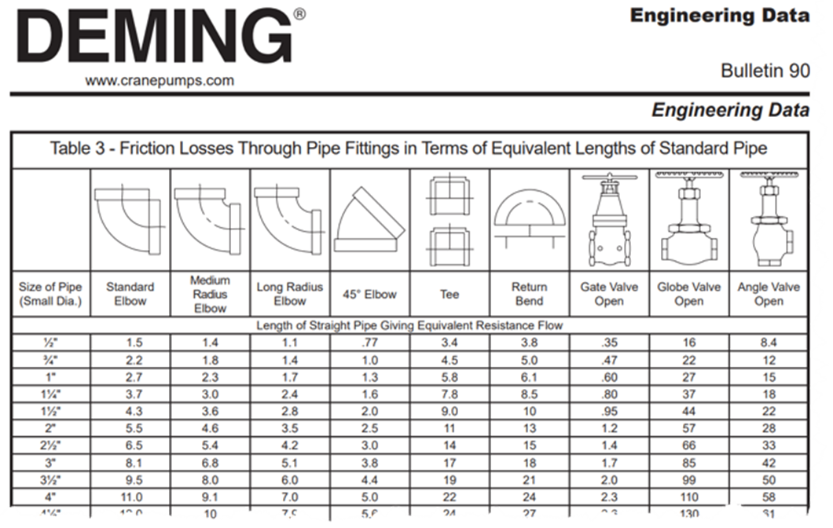
Equivalent Length Method for piping pressure loss

Slide 10
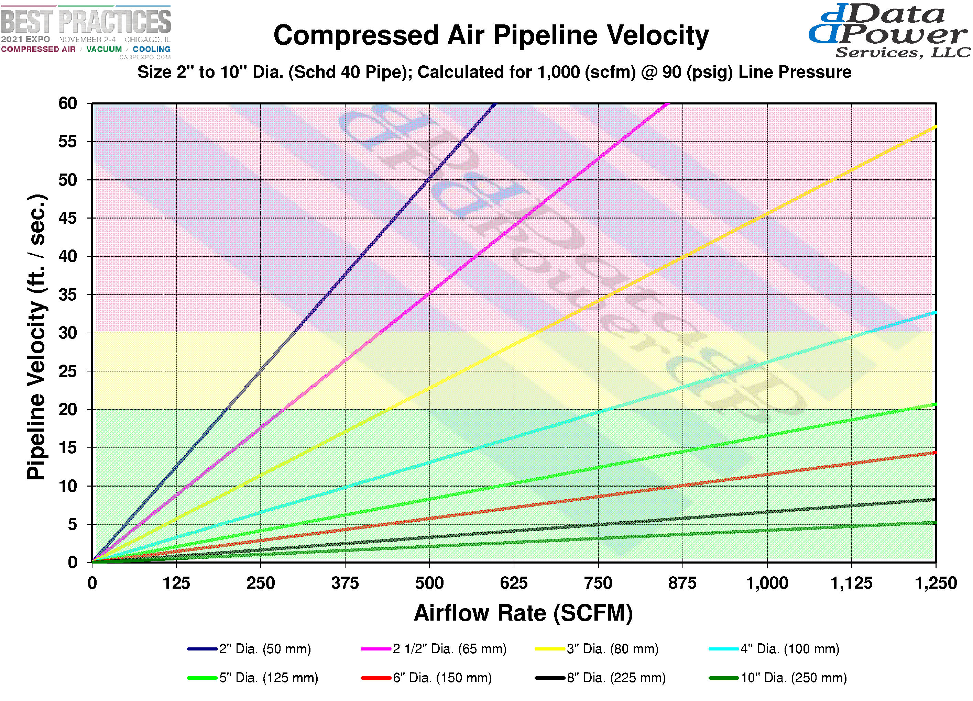
Equivalent Length Method for piping pressure loss
Notes:
Handouts include velocity charts and a handout from the Nashville 2019 EXPO Designing Piping Systems for Low Pressure Drop

Slide 11
Compressed Air System Operating parameters that impact pressure drop
Pipe Length (equivalent length) ${ f}_{x} ≈ \left(L\right) ∆P_{2}=∆P_{1}\left(\frac{L_{2}}{L_{1}}\right)$
Compressed Air Velocity $f_{x} ≈ \left(v^{2}\right) ∆P_{2}=∆P_{1}{\left(\frac{v_{2}}{v_{1}}\right)}^{2}=∆P_{1}{\left(\frac{Q_{2}}{Q_{1}}\right)}^{2}$

Slide 12
Pressure Loss from the source to tool ≤ 10%

Slide 13
Compressed Air System Pressure Profile

Slide 14
Compressed Air System Operating parameters that impact pressure drop
Pipe Length (equivalent length)
Compressed Air Velocity
Compressed Air Pressure

Slide 15
Piping restrictions and Pressure drop
Pipe Length (equivalent length)
Long pipe runs
Long hoses
Fittings, elbow, tee, valve
Restrictions
Filters
Quick Couplers
Undersize connectors
Abandoned Equipment

Slide 16
Excessive length of undersize hose
Average P5 is 10 sec. data interval
Sample Rate 25 samples / sec.
Minimum P5 is minimum reading during the interval
Notes:
Average readings are scan rate 25 s/sec average data interval 10 sec / data point

Slide 17
Printed circuit board drills & routers

Slide 18
Hose & pipe length
Transit bus manufacturer
Enough hose to go all the way around a bus and ½ way again.
100 ft hose reel under the work bench, the work area 25 ft across.
50 ft hose reel from the 17 ft high ceiling with 4 QD fittings connected to a torque gun.

Slide 19
Hose

Slide 20
More hose Air hose safety
Velocity Check or Whip Check
Flow
Pipe
Hose

Slide 21
More hose Air hose safety
Ball Vent Coupling
Velocity Check or Whip Check
Flow
Pipe
Hose

Slide 22
Hose connection

Slide 23
Abandoned Main Line Compressed Air Filter

Slide 24
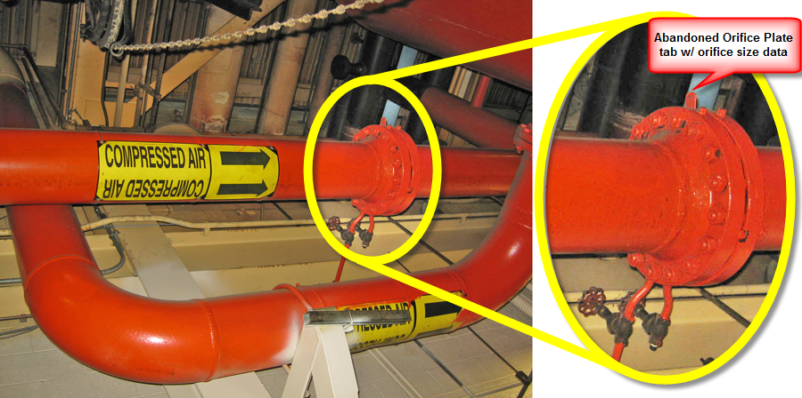
Abandoned Orifice Plate Flow Meter
10” diameter header with 13,800 cfm average air flow rate
Abandoned Flow Meter, 3 psid = 619,000 kWh / yr $43,330 / yr @ 0.07 / kWh
Notes:
619,000 kWh / yr @ 7 cents / kWh = $43,000 / year

Slide 25
High Velocity and Pressure Loss
Increasing air flow
Adding new air demands
Installing added compressor capacity
Leakage and compressed air waste
High volume intermittent peak air demand
Improper size components
FRL’s not sized for the end use air demand. Instead selected base on what’s available in the store room
Size based on average air flow rating rather than peak air flow

Slide 26
Compressed Air Velocity
Pressure loss $f_{x} ≈ \left(v^{2}\right)$
$∆P_{2}=∆P_{1}{\left(\frac{v_{2}}{v_{1}}\right)}^{2}=∆P_{1}{\left(\frac{Q_{2}}{Q_{1}}\right)}^{2}$
$∆P_{2}=3.72{\left(\frac{30}{20}\right)}^{2}$ $=3.72{\left(1.5\right)}^{2}$
$∆P_{2}=8.37$
$∆P_{2}=$ $3.72{\left(\frac{331}{221}\right)}^{2}$ $=$ $3.72{\left(1.497\right)}^{2}$
$∆P_{2}$ = 8.34

Slide 27
Increased air demand & compressor capacity. Pipe Size ???
Air Demand
700 cfm of flow @ 80 psig
2” diameter pipe
1000 ft long (equivalent length)
Pipe Capacity
w/ 90 psig Initial Pressure
362 cfm of flow @ 80 psig
700 cfm of flow @ 53 psig

Slide 28
Increased air demand & compressor capacity. ↑ Pressure ↑
Air Demand
700 cfm of flow @ 80 psig
2” diameter pipe
1000 ft long (equivalent length)
Pipe Capacity
Requires 120 psig Initial Pressure
30 psig increase from 90 psig target
724 cfm of flow @ 80 psig
~ 15% increased compressor kW
Distribution & Point of Use Pressure Drop????

Slide 29
700 cfm with 1000 ft of pipe – Increase Pipe Size
Air Demand
700 cfm of flow @ 80 psig
??” diameter pipe 3” or 4”
1000 ft long (equivalent length)
Pipe Capacity
90 psig Initial Pressure (original target)
3” Sch 40 5.5 psid branches, drop, POU
4” Sch 40 9.0 psid branches, drop, POU
~ 0% increased compressor kW
Distribution & POU Pressure Drop is Included

Slide 30
700 cfm with 1000 ft of pipe – Optimize Pipe Size & Pressure
Air Demand
700 cfm of flow @ 80 psig
3” diameter pipe
1000 ft long (equivalent length)
Pipe Capacity
85 psig Initial Pressure (< original target)
3” Sch 40 decrease pressure by 5.0 psig
~ 2.5% decreased compressor kW
Distribution & Point of Use Pressure Drop????

Slide 31
Compressed Air Velocity
Pressure loss $f_{x} ≈ \left(v^{2}\right)$
$∆P_{2}=∆P_{1}{\left(\frac{v_{2}}{v_{1}}\right)}^{2}=∆P_{1}{\left(\frac{Q_{2}}{Q_{1}}\right)}^{2}$
$∆P_{2}=3.72{\left(\frac{30}{20}\right)}^{2}$ $=3.72{\left(1.5\right)}^{2}$
$∆P_{2}=8.37$
$∆P_{2}=$ $3.72{\left(\frac{331}{221}\right)}^{2}$ $=$ $3.72{\left(1.497\right)}^{2}$
$∆P_{2}$ = 8.34

Slide 32
High Velocity = large pressure drop & pressure fluctuations
Pipeline pressure gradient measurement $Dp/Dx$
High pipeline velocity results in:
High pressure gradient - high velocity
18 psig pressure loss at the greatest flow rate 3,800 cfm
11 psig pressure loss at the lowest flow rate 2,250 cfm
Distribution piping is not tracking with supply pressure
Inverse mirror image of air flow rate and distribution piping pressure
Notes:
There is localized pressure loss. When air flow rate peaks, supply pressure decays by about 2 psi but the downward pressure excursion of distribution pressure is about 8 psig.
Sometimes there is a localized choke point in the distribution piping that can be corrected. Other times the air flow rate is just too high for the pipeline capacity.
With system wide pressure decay there is drawdown of both supply side and distribution piping pressure.

Slide 33
Localized Peak Air Demand

Slide 34
Localized Peak Air Demand – Secondary Storage w/ Refill Control
1,600 cfm
peak flow
~ 900 cfm
average flow

Slide 35
Lessons Learned
Restriction to flow (Equivalent Length)
High Velocity (Constant or Peak)
Excessively long hose
Poor connections
Undersize components FRLs
Unnecessary quick disconnects
Filters
Excessive or redundant over-filtration
Dirty filter elements, change regularly
Abandoned Equipment
Increasing compressed air demand
Increasing compressor capacity
Excessive leakage and waste
Size for peak flow (compressor sized for avg)
Reduce pipe velocity with secondary storage

Slide 36
About the Speaker
Director of Channel Development, FS-Curtis
Responsible for large rotary sales and compressed air system assessments
Compressed Air Industry since 1993, 10 Year with FS-Curtis
Sponsored by
Scott Folsom
FS-Curtis

Slide 37
The “System Approach” to maximizing compressed air system efficiency
Thursday March 25, 2021

Slide 38
The “system Approach” to maximizing compressed air system efficiency
If you have, then you’ve likely discovered that your compressed air system provides ample opportunity for energy efficiency improvements!
Have you ever asked yourself…
Do I need a new air compressor?
Reciprocating, Rotary Screw, or
Centrifugal?
Fixed speed or Variable speed?
Single stage or two stage?
Oil flooded or Oil free?
Does my air treatment equipment provide the air quality I need?
IS THERE ANYTHING ELSE I SHOULD BE CONSIDERING?
How can I maximize production efficiency?
How can I reduce scrap rate?
Is my plant operating at peak efficiency?
Is my “cost per widget” as low as it can possibly be?
What type of improvements will give me the greatest return?

Slide 39
The “system Approach” to maximizing compressed air system efficiency
Your previous questions are all valid and will need to be answered…
These questions only address concerns about the SUPPLY SIDE of your compressed air system!
What about the DEMAND SIDE?

Slide 40
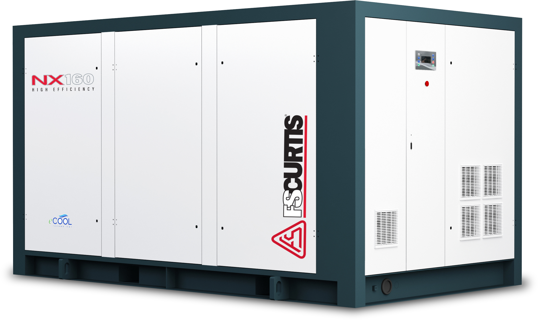
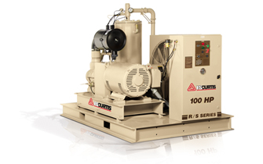
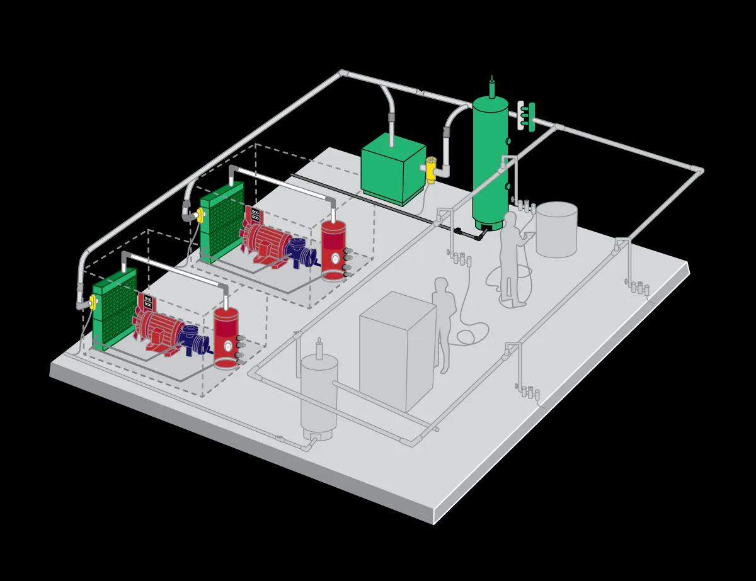
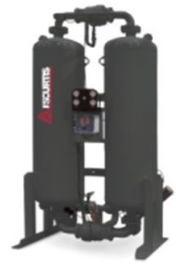
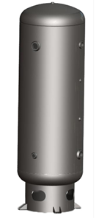
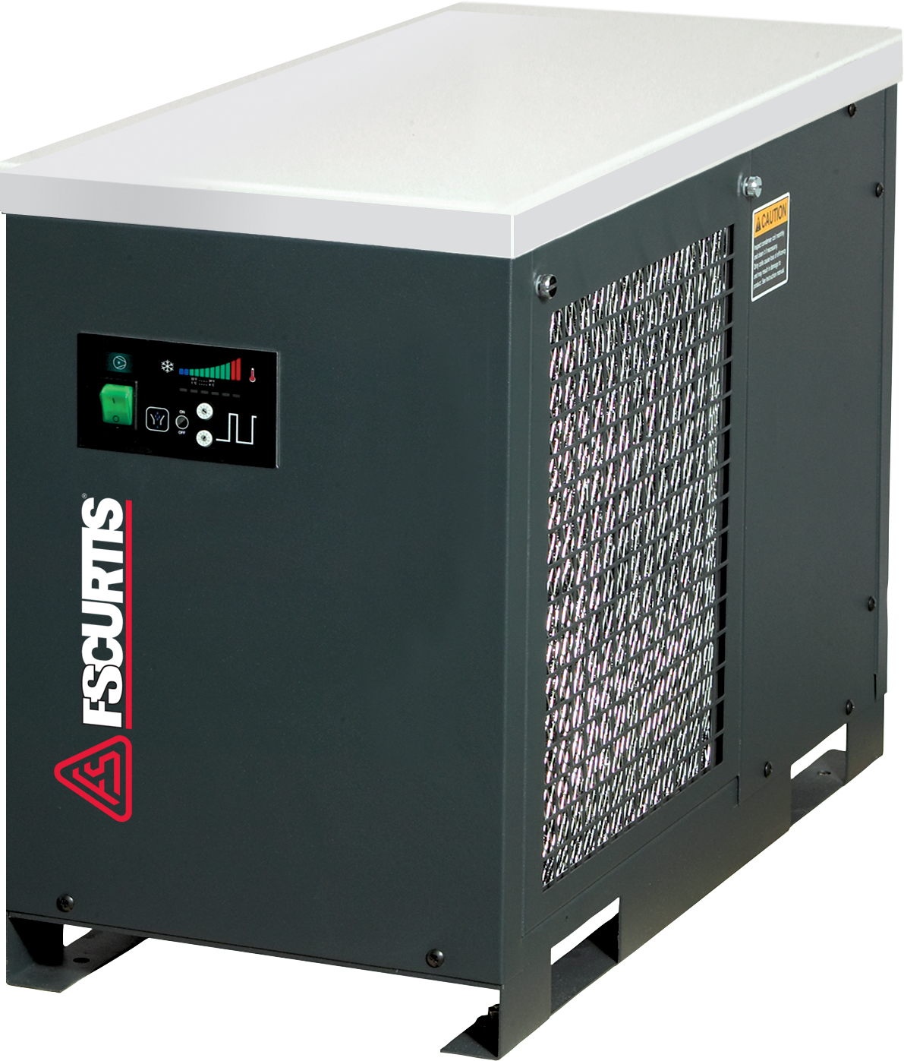
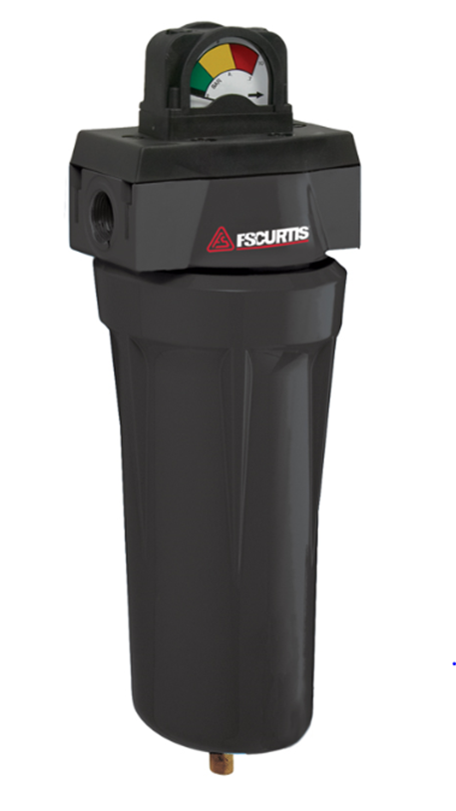
What is the supply side?
A typical compressed air system is made up of two major subsystems each containing various components.
SUPPLY SIDE & DEMAND SIDE.
Moisture separator
Condensate Drains
Oil/Water separator
Flow Controller
Bypass valves

Slide 41
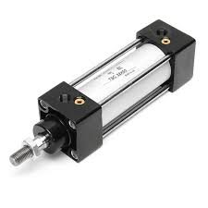
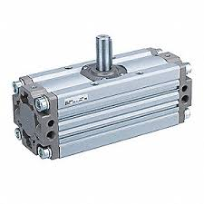
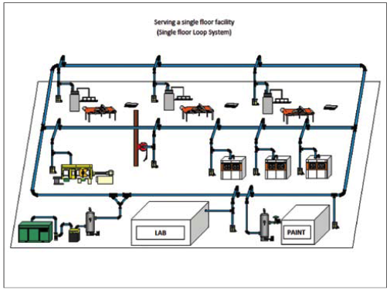
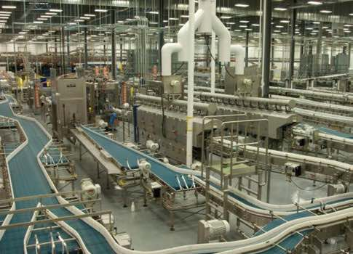
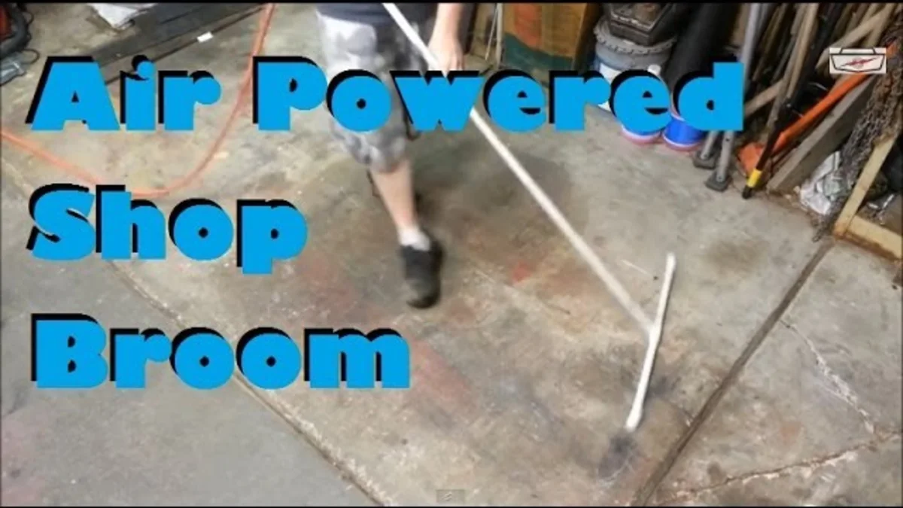
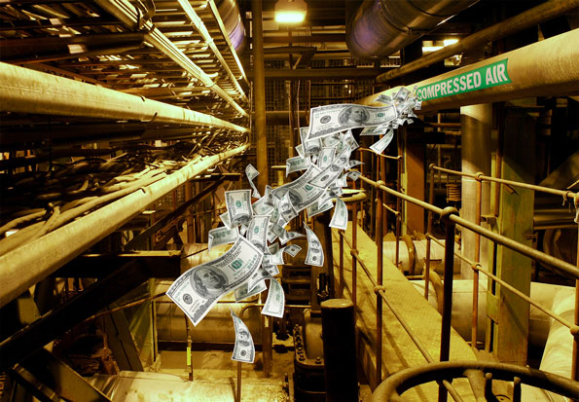
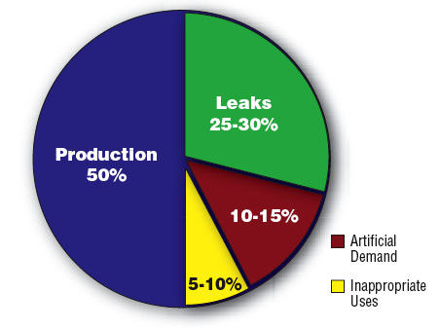
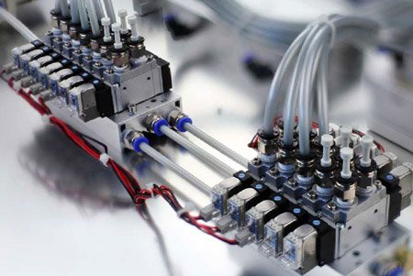
What is the Demand Side?
A typical compressed air system is made up of two major subsystems each containing various components.
SUPPLY SIDE & DEMAND SIDE.

Slide 42
Components of demand

Slide 43
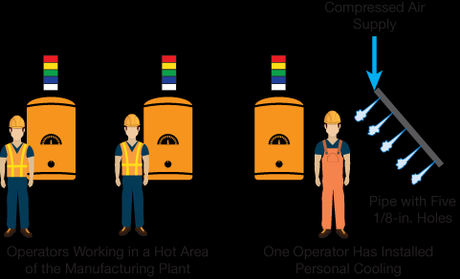
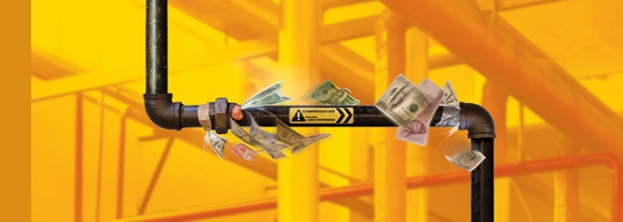
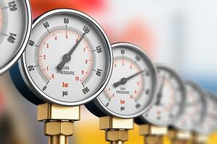
Components of demand
1. INAPPROPRIATE USES: any application that can be done more effectively and/or more efficiently by a method other than compressed air.
2. LEAKS: an unintended loss of compressed air to ambient conditions.
3. ARTIFICIAL DEMAND: increased demand due to excessive system pressure.
Typical components of demand
In a typical plant, demand for compressed air is a lot more than just what’s required to “do the work” (cylinders, rotary actuators, etc).
There are several “components of demand” that don’t produce any “work”…they’re completely unproductive and only waste energy!
Eliminating/minimizing these wasteful components of demand will save energy…and $$.

Slide 44
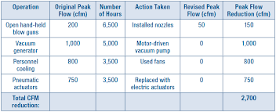
Inappropriate uses
Inappropriate uses
OPEN BLOWING
Processes such as cooling, bearing cooling, drying, clean up, or clearing jams on a conveyor.
Use a fan or low-pressure blower for general cooling, foot valves for air “shut off”, and a broom for clean up!
SPARGING
Aerating, agitating, oxygenating, or percolating liquid with compressed air.
Low pressure blowers are perfect for this!
DILUTE PHASE TRANSPORT
Used in transporting solids such as powdery material in a diluted format with compressed air.
Low pressure blower!
VACUUM VENTURI’s
Compressed air is forced through an engineered nozzle that causes an increase in air velocity and an associated decrease in pressure, to below atmospheric (vacuum).
Use a dedicated vacuum pump instead!
PERSONAL COOLING
Production employees direct compressed air upon themselves to provide ventilation.
Use a fan!
Any application that can be done more effectively and/or more efficiently by a method other than compressed air.

Slide 45
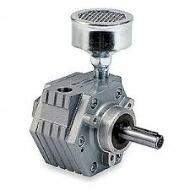
Compressed air vs other energy sources
Compressed air is a necessary part of most plant operations, but it is NOT the most efficient source of energy in a plant.
Example: Powering a 1 HP air motor.
The 1 hp air motor requires 30 acfm @ 90 psig.
7-8 hp (5-6 kW) is required at the compressor to produce 30 acfm @ 90 psig.
A 5 day/wk, 2 shifts/day plant that pays $.10/kW-hr, will spend $2,330/yr to produce the 30 acfm @ 90 psig required.
A 1 hp ELECTRIC motor will cost $390/yr.
YOU DO THE MATH!

Slide 46
leaks
Discharge of air through an orifice
scfm for stated orifice size in inches
leaks
psig | 1/64” | 1/32” | 1/16” | 1/8” | ¼” | 3/8”
70 | .30 | 1.20 | 4.79 | 19.2 | 77 | 173
80 | .34 | 1.34 | 5.36 | 21.4 | 86 | 193
90 | .37 | 1.48 | 5.92 | 23.8 | 95 | 213
100 | .41 | 1.62 | 6.49 | 26.0 | 104 | 234
125 | .50 | 1.98 | 7.90 | 31.6 | 126 | 284
An unintended loss of compressed air to ambient conditions.
Leak flow rate is a function of pressure in an uncontrolled system.
Higher pressure = greater leak flow.
Lower pressure = less leak flow.
Leaks happen in the compressor room, the interconnecting piping, the tanks, the joints of the plant piping system, the “dirty 30”, and the production equipment itself…
EVERY PLACE WHERE SOMETHING IS CONNECTED TO SOMETHING ELSE IS A POTENTIAL LEAK POINT.
Control waste due to leaks by minimizing the supply pressure, or…FIX THE LEAKS!
All unregulated uses will use more air when pressure increases.
A $200/yr leak cannot be felt or heard.
An $800/yr leak can be felt but not heard.
A $1,400/yr leak can be felt and heard.

Slide 47
leaks
With a proactive leak management campaign, leak flow rate can be reduced to 5-10% of total compressed air production capacity.
Leaks are inevitable and cannot be 100% eliminated…even a brand new piping system will have leaks regardless of what type of pipe is used.
IT’S NOT JUST ABOUT WASTED ENERGY…there are other operational losses associated with compressed air leaks.
Leaks cause a pressure drop in the system, which can negatively affect production efficiency and product quality…leading to missed KPI metrics, and increased scrap rate.
Leaks cause supply side equipment to “cycle” more frequently…shortening the life span…including the air compressor!
Leaks can cause increased compressor run time, which increases maintenance requirements and expenditures.
Leaks can lead a customer to purchase unnecessary horsepower. Fix your leaks, THEN let us come in and evaluate your system for new compressor needs.
Leaks can be a very significant source of wasted energy in a compressed air system…upwards of 20-30% of a compressed air system’s full load output capacity can be wasted on “feeding the beast”…leaks!

Slide 48
Estimating Leak Load
You can estimate leak load by observing the behavior of the pressure in the air receiver (tank).
Determine the ENTIRE system storage capacity volume (V) in cu ft. INCLUDE ALL PIPING IN THE PLANT & POINT OF USE TANKS!
Install a pressure gauge in or immediately downstream of the air receiver.
Bring the plant up to system pressure and shut off the air compressor.
Measure the time (T) it takes for the plant pressure to decay from MAX pressure (P1) to MIN pressure (P2 – usually about ½ of normal operating plant pressure), and apply some simple algebra…
Leakage (acfm) = [V x (P1-P2) / (T x 14.7)] x 1.25
V = total system storage volume in cu ft
P1 = max pressure in tank
P2 = min pressure in tank
T = time in minutes
1.25 = corrects leakage to normal system pressure…LEAKS LEAK LESS AIR AT LOWER PRESSURE!

Slide 49
Artificial demand
Discharge of air through an orifice
scfm for stated orifice size in inches
Artificial demand
psig | 1/64” | 1/32” | 1/16” | 1/8” | ¼” | 3/8”
70 | .30 | 1.20 | 4.79 | 19.2 | 77 | 173
80 | .34 | 1.34 | 5.36 | 21.4 | 86 | 193
90 | .37 | 1.48 | 5.92 | 23.8 | 95 | 213
100 | .41 | 1.62 | 6.49 | 26.0 | 104 | 234
125 | .50 | 1.98 | 7.90 | 31.6 | 126 | 284
Increased demand due to system pressure set higher than required to keep production equipment operating properly…excessive system pressure.
Leak flow rate is a function of pressure in an uncontrolled system.
Higher pressure = greater leak flow.
Lower pressure = less leak flow.
All unregulated uses will use more air when pressure increases (open blowing, blowguns, production equip w/o point of use regulator…).
A 3/8” orifice will leak 284 acfm @ 125 psig.
A 3/8” orifice will leak 234 acfm @ 100 psig.
Lowering pressure by just 10 psig reduces consumption by 50 acfm…that’s a 15hp air compressor!

Slide 50
summary
IN SUMMARY…
If you want to cut costs, reduce unproductive components of demand!
Wasteful components of demand (that don’t relate to production):
Inappropriate Uses
Explore more efficient technologies.
Educate and eliminate inappropriate uses by plant personnel.
Leaks
If left unmanaged, leaks can consume up to 30% of the total compressed air capacity in a system.
Artificial Demand
Lower your plant pressure by controlling leaks and minimizing pressure drop.
A typical compressed air system provides ample opportunity for improved efficiency.
Addressing only the supply side of the compressed air system (air compressors, dryers, filters, tanks) will not maximize the overall efficiency of the system!
Use the System Approach and analyze both the supply side and the DEMAND side for maximum efficiency improvements!

Slide 51
Thank you!

Slide 52
Common Causes & Solutions for Compressed Air Pressure Drop
Q&A
Please submit any questions through the Question Window on your GoToWebinar interface, directing them to Compressed Air Best Practices Magazine. Our panelists will do their best to address your questions and will follow up with you on anything that goes unanswered during this session.
Thank you for attending!
Sponsored by

Slide 53
Thank you for attending!
The recording and slides of this webinar will be made available to attendees via email later today.
PDH Certificates will be e-mailed to Attendees within 2 days.

Slide 54
April 2021 Webinar How to Correctly Apply & Size Oil-Free Vacuum Pumps
Sponsored by
Andy Smiltneek
Growth Solutions Consultants
Keynote Speaker
Thursday, April 22, 2021 – 2:00 PM EST
Register for free at
www.airbestpractices.com/magazine/webinars

