Slide 1


Compressed Air Piping Sizing & Design
Tim Dugan, Compression Engineering Corporation
Keynote Speaker
Sponsored by
The recording and slides of this webinar will be made available to attendees via email later today.
PDH Certificates will be e-mailed to attendees within 2 days.

Slide 2

Q&A Format
Panelists will answer your questions during the Q&A session at the end of the Webinar.
Please post your questions in the Questions Window in your GoToWebinar interface.
Direct all questions to Compressed Air Best Practices® Magazine
Sponsored by

Slide 3
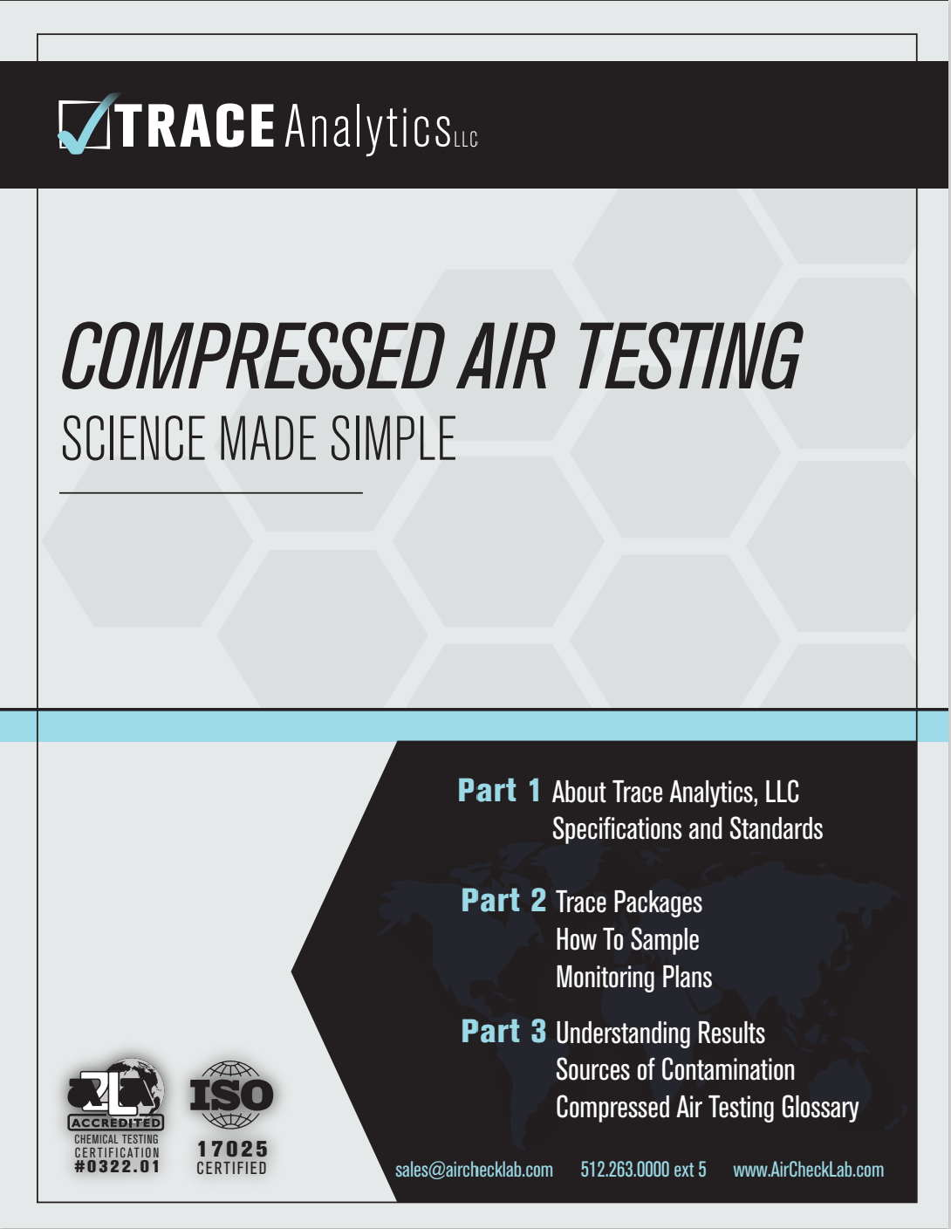
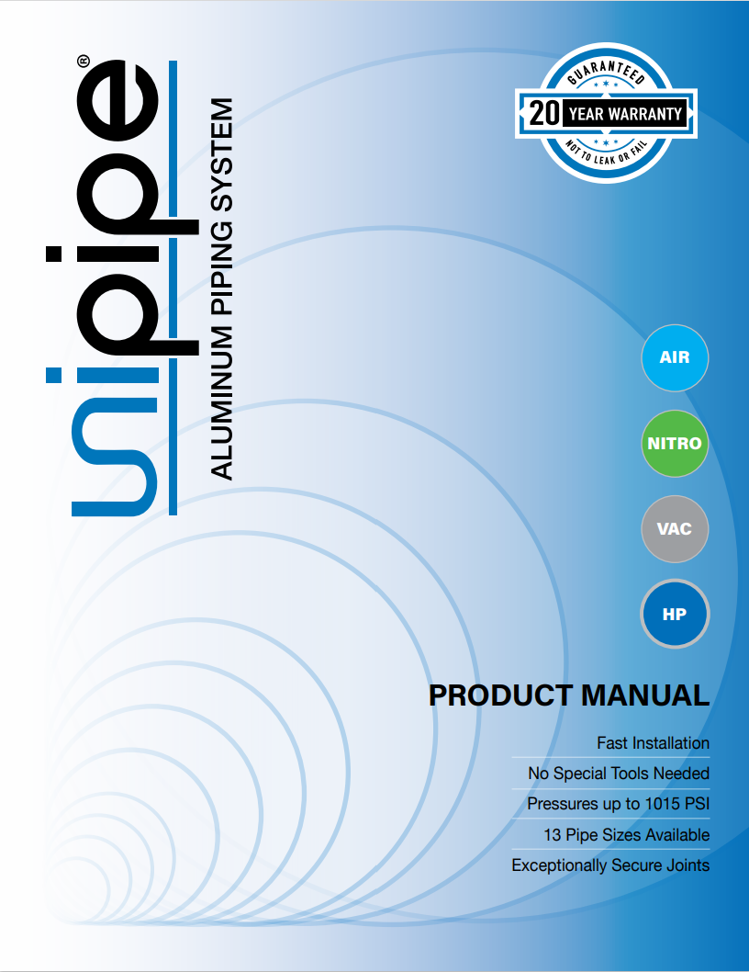



Handouts

Slide 4
Disclaimer
All rights are reserved. The contents of this publication may not be reproduced in whole or in part without consent of Smith Onandia Communications LLC. Smith Onandia Communications LLC does not assume and hereby disclaims any liability to any person for any loss or damage caused by errors or omissions in the material contained herein, regardless of whether such errors result from negligence, accident, or any other cause whatsoever.
All materials presented are educational. Each system is unique and must be evaluated on its own merits.

Slide 5


Slide 6
Compressed Air Piping System Sizing & Design
Introduction by
Compressed Air Best Practices® Magazine
Sponsored by

Slide 7

About the Speaker
President and Principal Engineer, Compression Engineering Corporation
Over 32 years of experience in the industry
20 years of independent consulting experience
Tim Dugan, P.E.
Compression Engineering Corporation
Sponsored by

Slide 8
Outline
Primary Design Criteria
Bad Example
Basic Theory of Pressure Drop in Piping
Recommended Template Design
Conclusions

Slide 9
Primary Design Criteria
Production: Even Pressure Distribution at All Loads
Energy: Minimum Energy Loss from Pressure Loss
Installation Cost: Minimum Cost
Flexibility: Ability to Maintain System
Life: Minimum Corrosion Over Life

Slide 10
Production and Energy Focus
Minimum Pressure Drop:
  End-to-end
  Comp Room to Comp Room
  Point-of-use Drops and Hoses
  Consider Dynamic Losses, Particularly at POU
Consider Automation Impact on Dynamic Pressure Drop:
  Running Compressors From Different Areas
  Fully Loading Base-load Compressor Far From Primary Demand
  Trimming Compressors From Different Location
  Piping DP Can Reduce Operating Pressure Band or Cause “Control Gap”

Slide 11
Bad Example
Grossly Oversized Main Line
Grossly Undersized Point of Use with Peak Demands
Terrible Pressure Control at Compressors
Inefficiency – and Focusing on the Wrong Thing

Slide 12
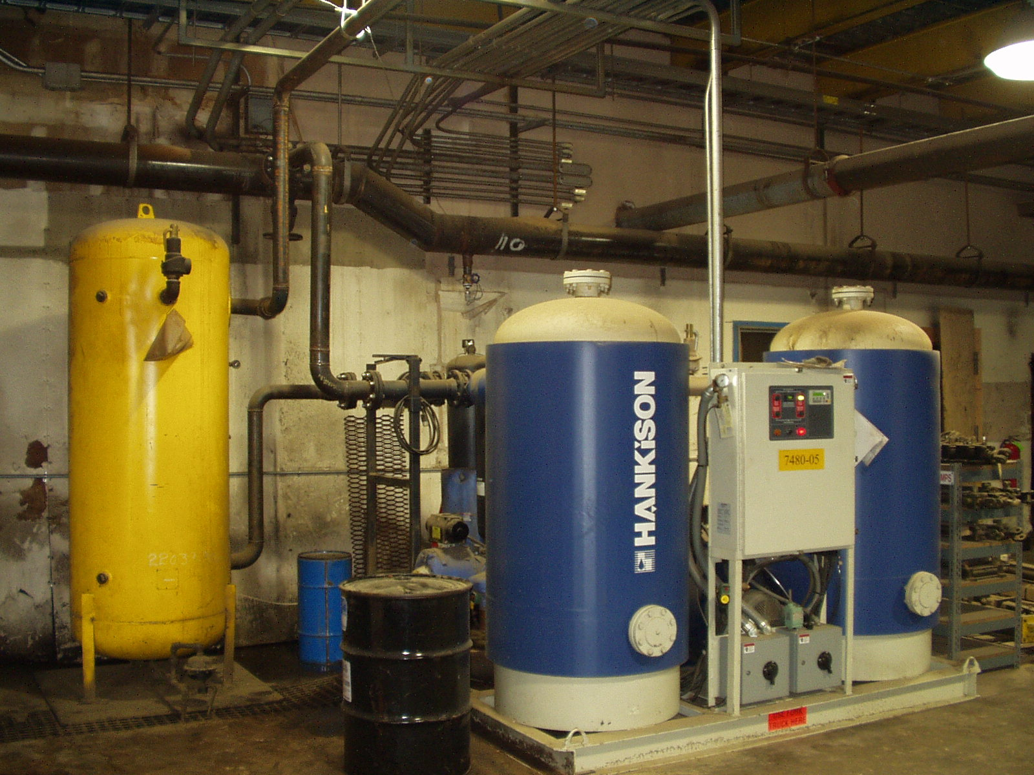
Bad Example
Grossly Oversized Main Line: 10”
Typically, Sawmills Have 4-6” Main

Slide 13
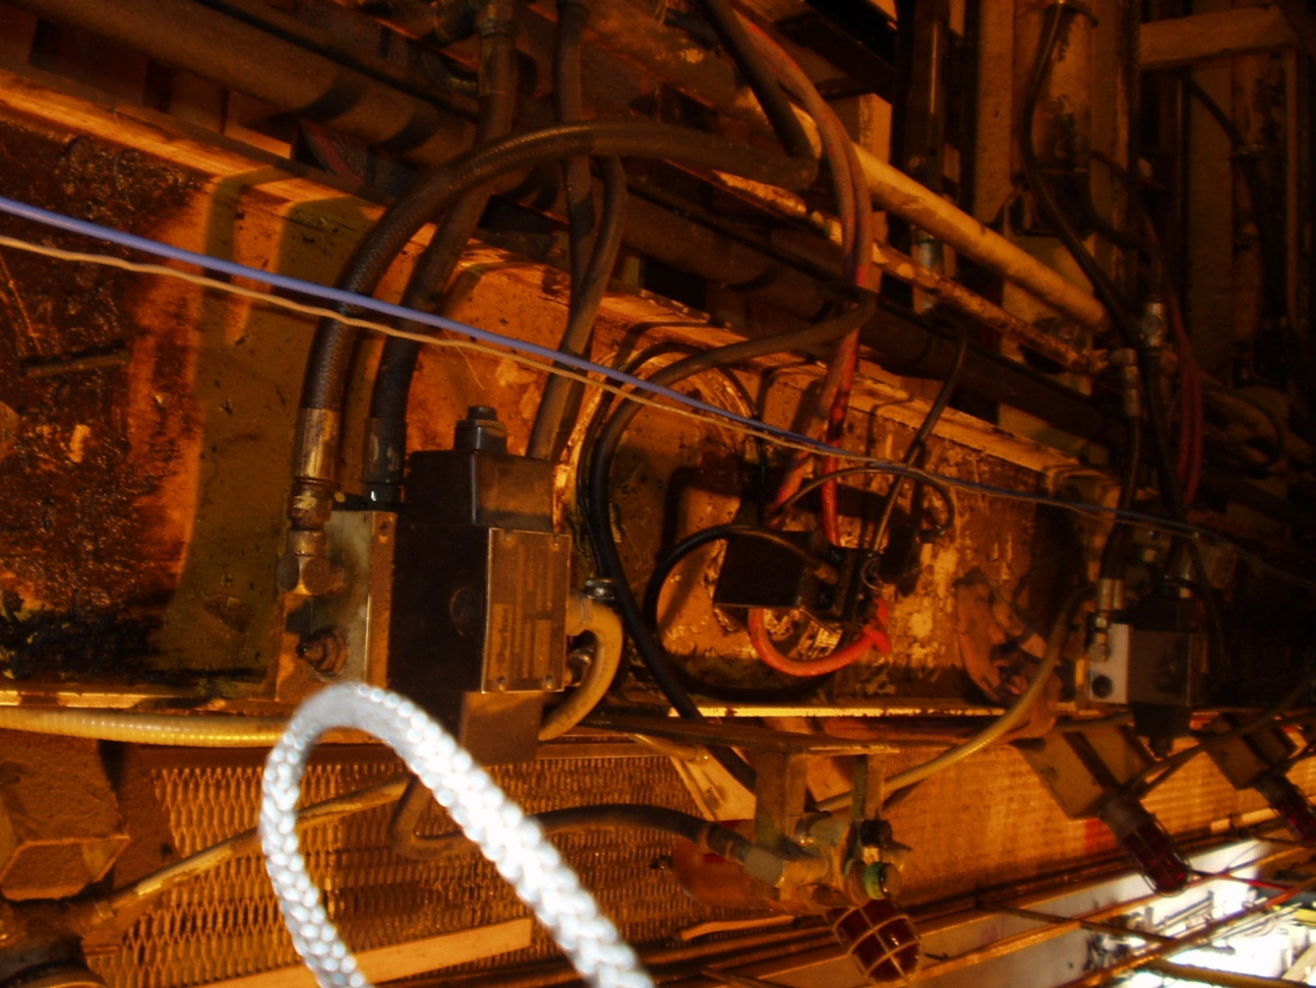
Bad Example
Grossly Undersized Point of Use Lines, w/ Dynamic Demands
Linear Process (Sorter)
2” Dead Run, Reduced to ¾”,Then Up to 1.25”
(5) Manifolds for “Tipplers”, With:
  (1) ½” Hose
  (1) Oiler
  (1) ½” sch40 Manifold
  (4) Valves Fed Off Each Manifold Via ¼” Hoses

Slide 14
Bad Example
Terrible Pressure at Tipplers:
Dynamic Dip to 30 psig
Main Line Pressure Wasn’t The Dynamic Issue
Main Line Drifted w- Modulation Controls

Slide 15
Bad Example

Slide 16
Bad Example
P1 Slowly Varied 30 psig from Inlet Modulation
P1-P2 = 0.5 psi
P2-P3 = 0-70 psig – Dynamic

Slide 17
Bad Example - Recommendations
Maintain Oilers, Filters, Etc.
Increase All Lines by 2X at POU
Install 4,000 gal Storage
Install Lead-lag PLC Controls
Paint Murals on 10” Piping

Slide 18
Bad Example - Lessons
Lessons:
System-wide Pressure Problems Are Caused by Compressor Controls, Not Piping
Localized Pressure Problems Caused by “The Last 10 Yards” of Piping

Slide 19
Basic Pressure Drop Theory
Air flow rate is proportional to the velocity x area:
  Double the velocity and you double the flow, double the area and you double the flow
Velocity is proportional to the inverse of the square of the diameter:
  Half the diameter and you quadruple the velocity
Pressure drop is proportional to mass flow to the 1.85 power
  Double the scfm results in about four times the DP

Slide 20
Basic Pressure Drop Theory
Pressure drop is proportional to the inverse of the diameter to the 5th power:
  Half the diameter results in 32 X the delta P
Pressure drop is inversely proportional to pressure:
  Half the pressure results in double the pressure drop
Putting this all together:
  Theoretically, Δp=f x L / d x ​ρ x V^2​
  Emperically, Δp = Constant x q^{1.85} x L x 10⁴ / (d⁵ p)
  https://www.engineeringtoolbox.com/ansi-steel-pipes-d_305.html
  Constant for metric units = 7.57 in Source, Corrected to 9.25 to Match CAGI
  Constant in US Units = 7.63 E-08

Slide 21
Counter-Intuitive Effect
If Delta P is Reduced and No Controls Updated/Adjusted, Energy Can go UP
Pressure at end uses will go UP, and artificial demand will INCREASE
Thus, Every Piping Project Should Include Controls Adjustments. You Should be Reducing Compressor Controls Set Points Afterwards.
If System is Complex, Get an Expert to “Recommission” It
If System Doesn’t Have Master Controls and Adequate Storage, They Should be Added as Next Step or at Same Time

Slide 22
Basic Piping Design Rules
Design Piping for < 5.0 psi Delta P per 1000 ft
Use Equivalent Length Method for Fittings
Don’t Use 30fps Rule
Don’t Need to Change to Swept Angled Fittings

Slide 23
Basic Piping Design Rules
Assume Full Flow of All Compressors for Transmission Line
Assume Peak Flow x Growth for Each Loop
Assume Half of Loop Flow on Each Side of Loop
Assume Half of Apportioned Peak Loop Flow for Ladder Rungs
Use Same Drops Throughout, Sized for Highest Machine Center
Min 3X Length From Ladder to Machine Center
Put All Filtration in Compressor Room & Use Right Piping Material
Remove POU Filters Unless High Purity Requires

Slide 24
Pressure Drop Chart
My Chart:

Slide 25
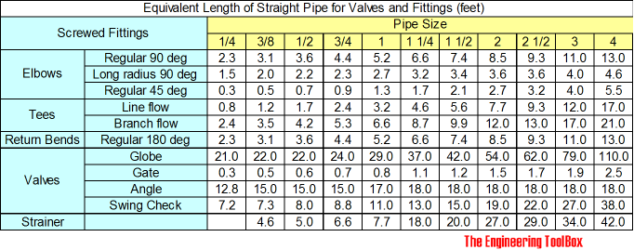
Fitting Pressure Loss
Simplest Method is “Equivalent Length”
Add Actual Length of Pipe to Fitting Equiv. Length and use That for Delta P calc

Slide 26
Recommended Template Design
“Electrical Distribution” Concept, Base System:

Slide 27
Recommended Template Design
Future Expanded System:

Slide 28
Conclusions
Do An Audit First
Develop System Design
Don’t Oversize Piping Where Not Needed
Don’t Undersize Piping Where Most Needed
Include New Master Controls or Re-commissioning in Piping Project
Design for Future Growth

Slide 29

About the Speaker
Customer Service and Sales Manager, Trace Analytics
Experienced in customer service with a passion for problem solving
HACCP certified
Trace Analytics is an A2LA accredited laboratory specializing in compressed air and gas testing
Erin Zimmerman
Trace Analytics
Sponsored by

Slide 30
SOURCES OF CONTAMINATION
HOW YOUR DISTRIBUTION SYSTEM
CAN AFFECT AIR QUALITY
Erin Zimmerman with Trace Analytics

Slide 31
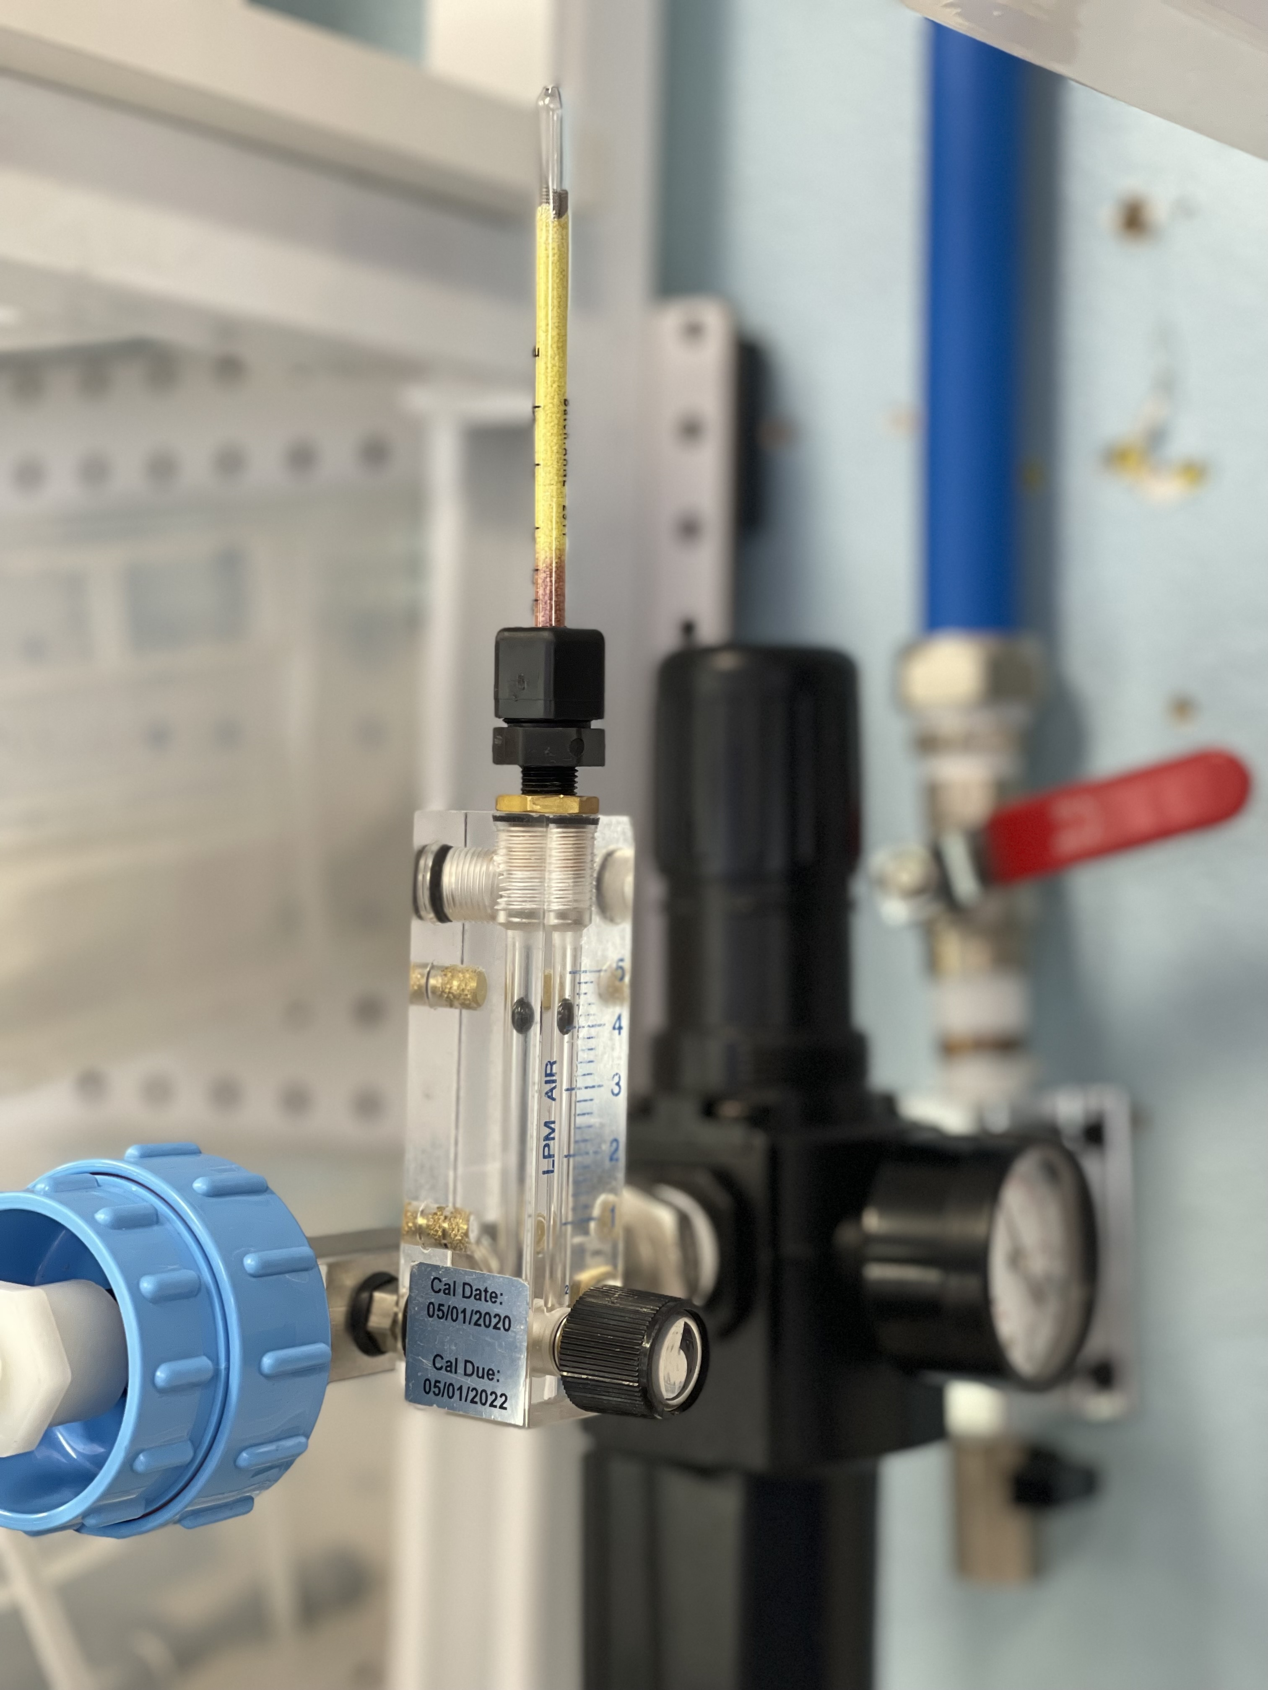




FREQUENCY OF TESTING
Some specifications require “risk-based”
Trace Analytics recommends Quarterly
Risk Assessments will help you determine where to test and how often
PERCENTAGE
MAINTENANCE
MINIMAL
SINGLE
TRACE ANALYTICS, LLC | ERIN ZIMMERMAN | SALES@AIRCHECKLAB.COM | 1-800-247-1024 X 5

Slide 32


DISTRIBUTION MATERIALS

Slide 33
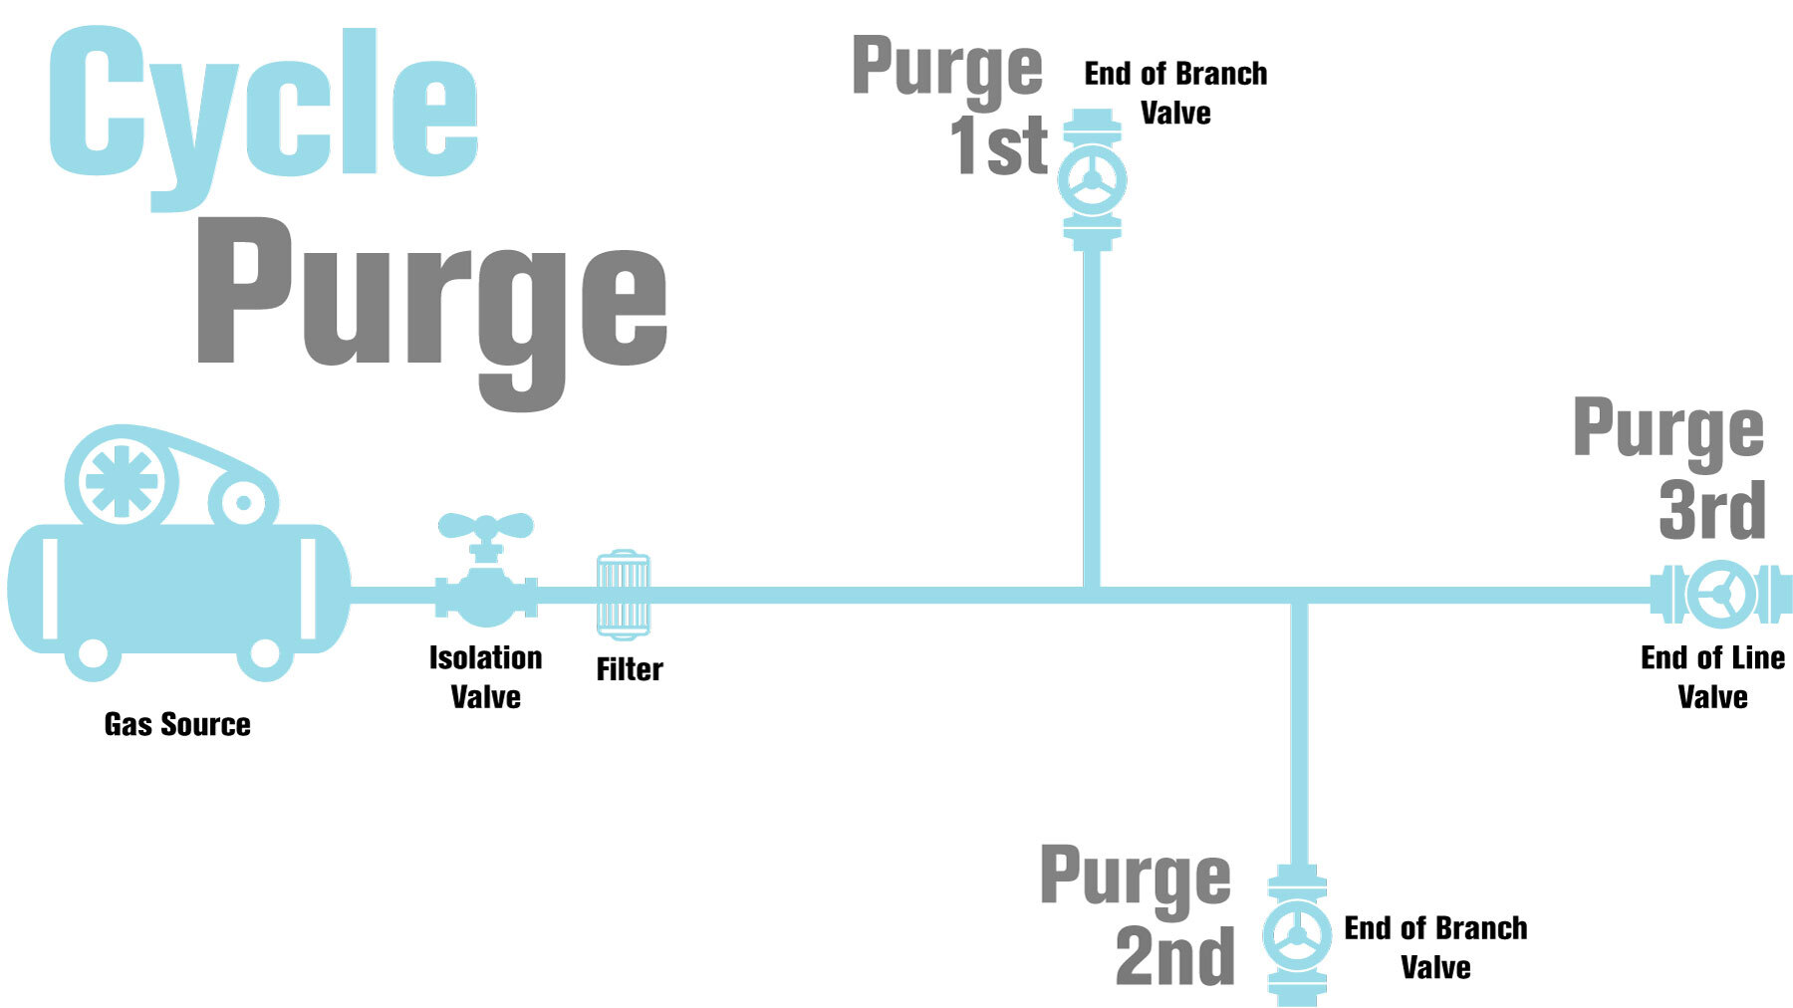
CYCLE PURGE

Slide 34
PARTICLE CONTAMINATION

Slide 35
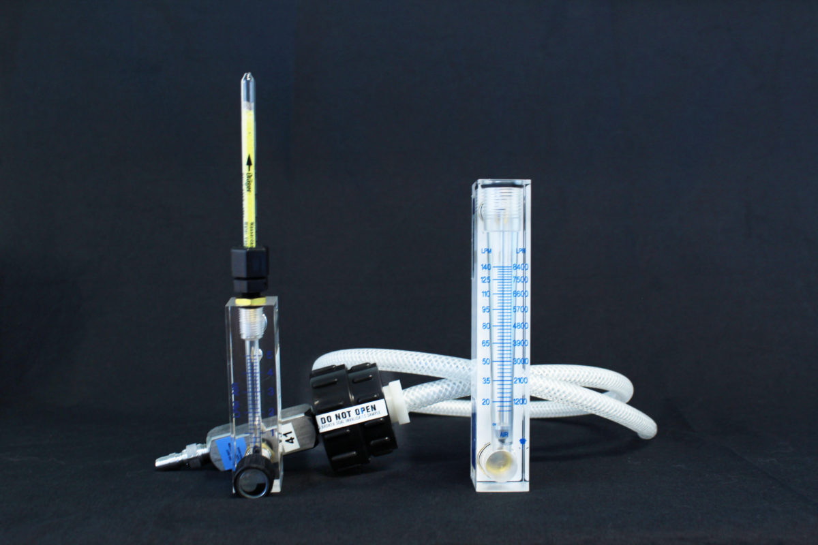
WATER CONTAMINATION
Use Detector Tubes for testing and troubleshooting water contamination on-site without having to wait for a lab to return a report.
CONTAMINANTS
SOURCE
TROUBLESHOOTING
Rust, corrosion, and microbial growth.
Ambient air around the compressor – especially during humid months.
Test on-site with detector tubes to troubleshoot contamination
TRACE ANALYTICS, LLC | ERIN ZIMMERMAN | SALES@AIRCHECKLAB.COM | 1-800-247-1024 X 5

Slide 36
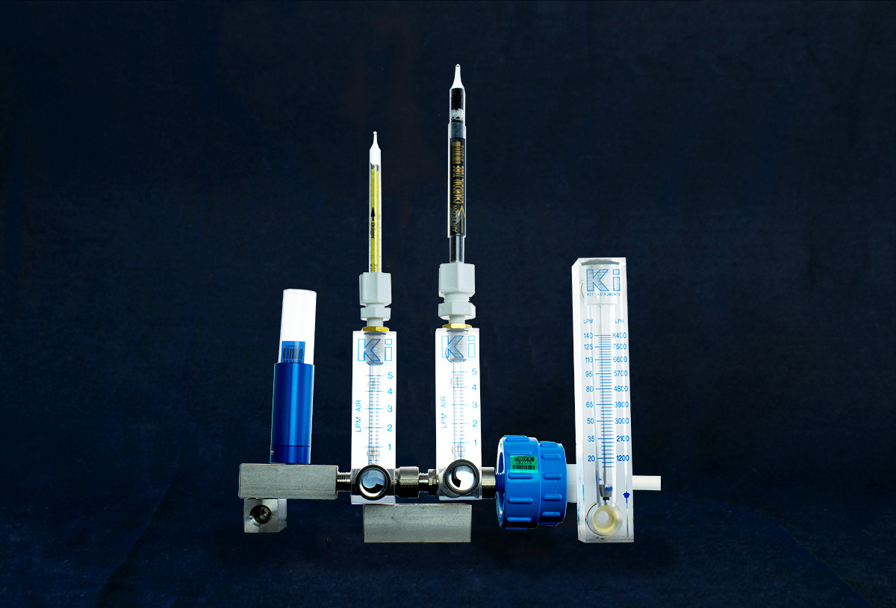
TOTAL OIL
Common terms for oil include:
Aerosols
  condensed hydrocarbons
  oil mist
  oil aerosol
Vapor
  total gaseous hydrocarbons
  and total volatile hydrocarbons or TVHC
ISO 8573 purity classes 1 and 2 include both oil aerosol and oil vapor analysis
TRACE ANALYTICS, LLC | ERIN ZIMMERMAN | SALES@AIRCHECKLAB.COM | 1-800-247-1024 X 5

Slide 37

MICROBIAL CONTAMINATION
Incubation and analysis by a lab can take up to 14 days or more
Microbes may consume:
  Plastics
  Rust
  and oil
ISO 8573 requires microbial sampling with an impaction sampler
Benefit of Microbial Testing
  Provides insight into cleaning and sanitization protocols
TRACE ANALYTICS, LLC | ERIN ZIMMERMAN | SALES@AIRCHECKLAB.COM | 1-800-247-1024 X 5

Slide 38
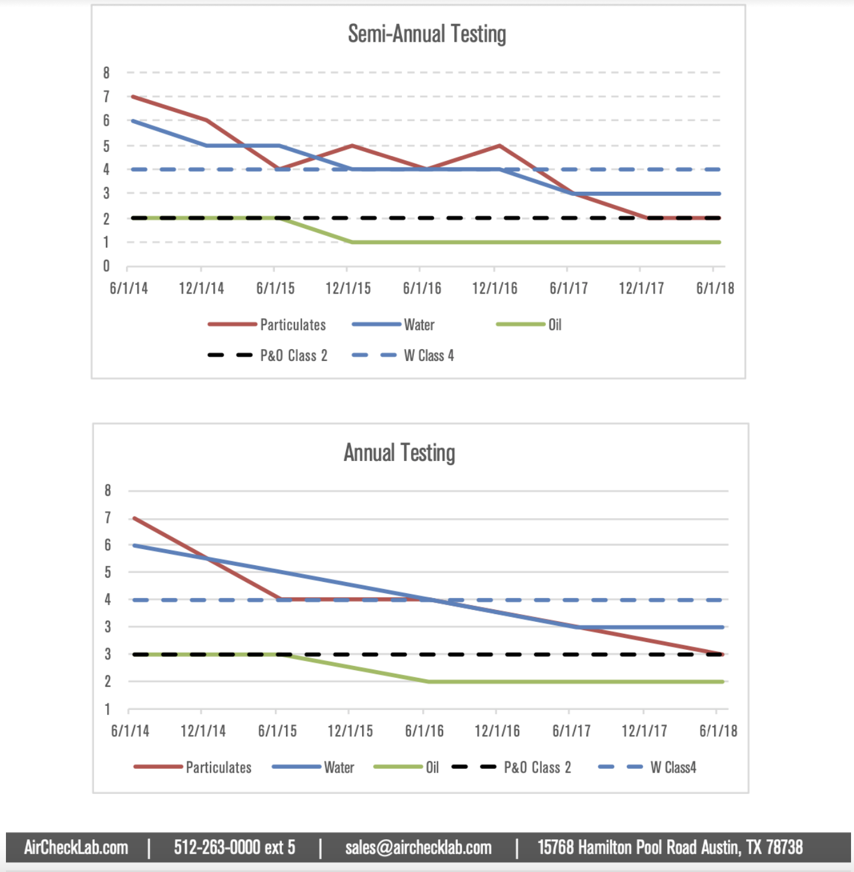
UNDERSTANDING RESULTS
Create trend analyses with regular testing
TRACE ANALYTICS, LLC | ERIN ZIMMERMAN | SALES@AIRCHECKLAB.COM | 1-800-247-1024 X 5

Slide 39
UNDERSTANDING RESULTS
TRACE ANALYTICS, LLC | ERIN ZIMMERMAN | SALES@AIRCHECKLAB.COM | 1-800-247-1024 X 5

Slide 40
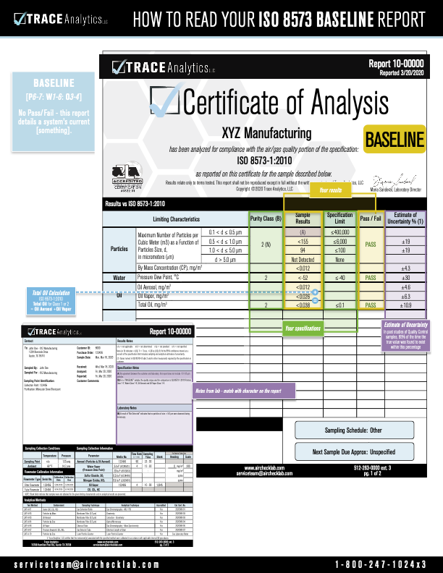
EXAMPLE REPORT
This report is an example of a baseline sample taken
Baseline testing is a good starting point
See purity classes, your results, and your limits
Trace Combines Total Oil (aerosol + vapor)
calibration information and sample documentation on the the back
TRACE ANALYTICS, LLC | ERIN ZIMMERMAN | SALES@AIRCHECKLAB.COM | 1-800-247-1024 X 5

Slide 41
HAVE A QUESTION WE DIDN’T COVER?
TRACE ANALYTICS, LLC | ERIN ZIMMERMAN | SALES@AIRCHECKLAB.COM | 1-800-247-1024 X 5

Slide 42

About the Speaker
Lifelong Career in Compressed Air
Co-Owner Fluid-Aire Dynamics
  Chicago, Milwaukee, Minneapolis, Detroit, and San Antonio
Co-Owner and Product Director
  PneuTech USA and Unipipe
Derrick Taylor
Unipipe
Sponsored by

Slide 43
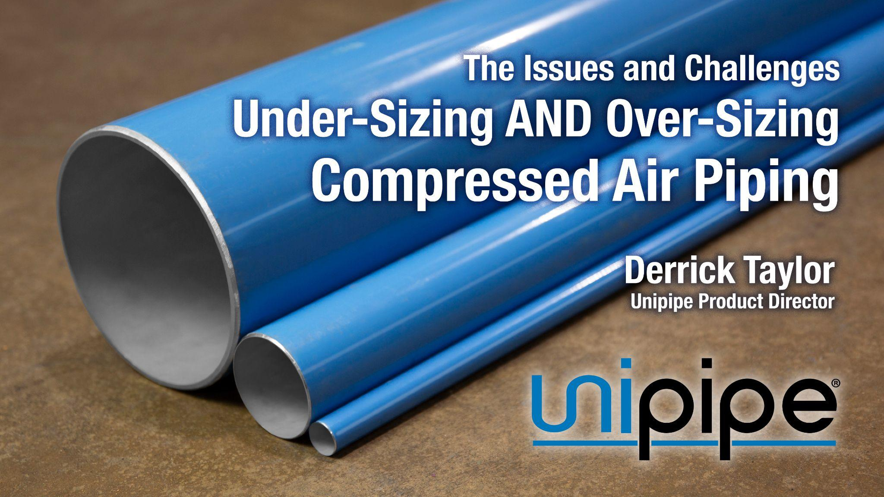

Slide 44
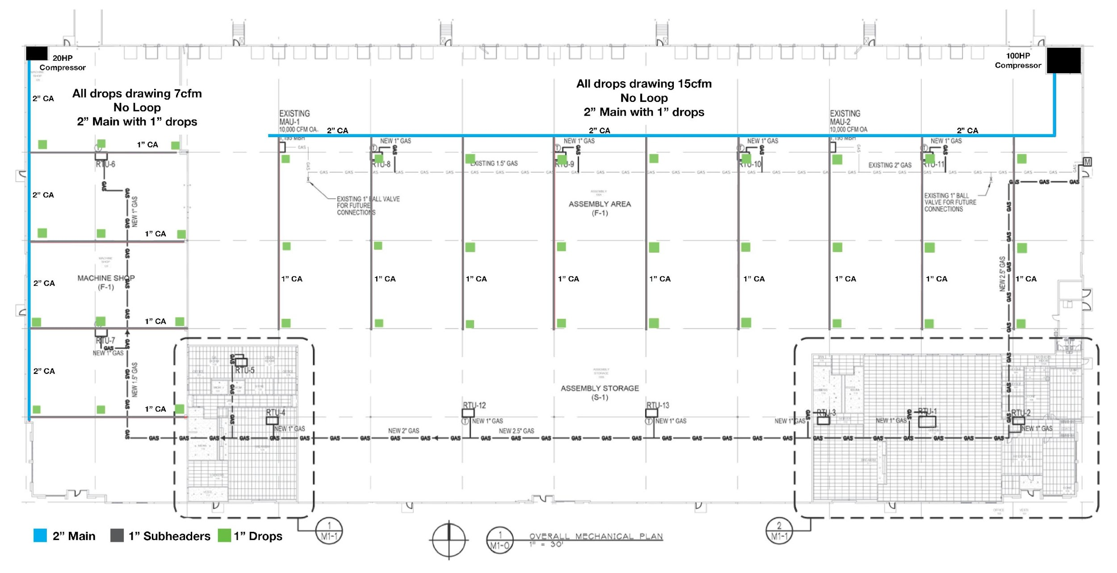





Commonly Under-Sized System 2” Headers / 1” Subheaders / 1”Drops + Dead End Layout
Not a Loop Type System
Not Every Drop will Have the same PSI
Two separate systems are the same although vastly different supply and demand
PSID to final Drop is almost 15 PSID
Installed Cost
Pipe & Fittings $27,700
Labor $15,700
Total Cost $43,400

Slide 45
Under-Sized Piping Leads to Pressure Drop
Pressure drop from the “compressor room” to the point of use should not exceed 3 - 5 PSI
Golden Rule: 2PSI in system pressure reduction, saves 1% in energy
Reducing system pressure is difficult if piping is marginally sized or undersized
Consider the possibility of future expansion and/or additional machinery

Slide 46
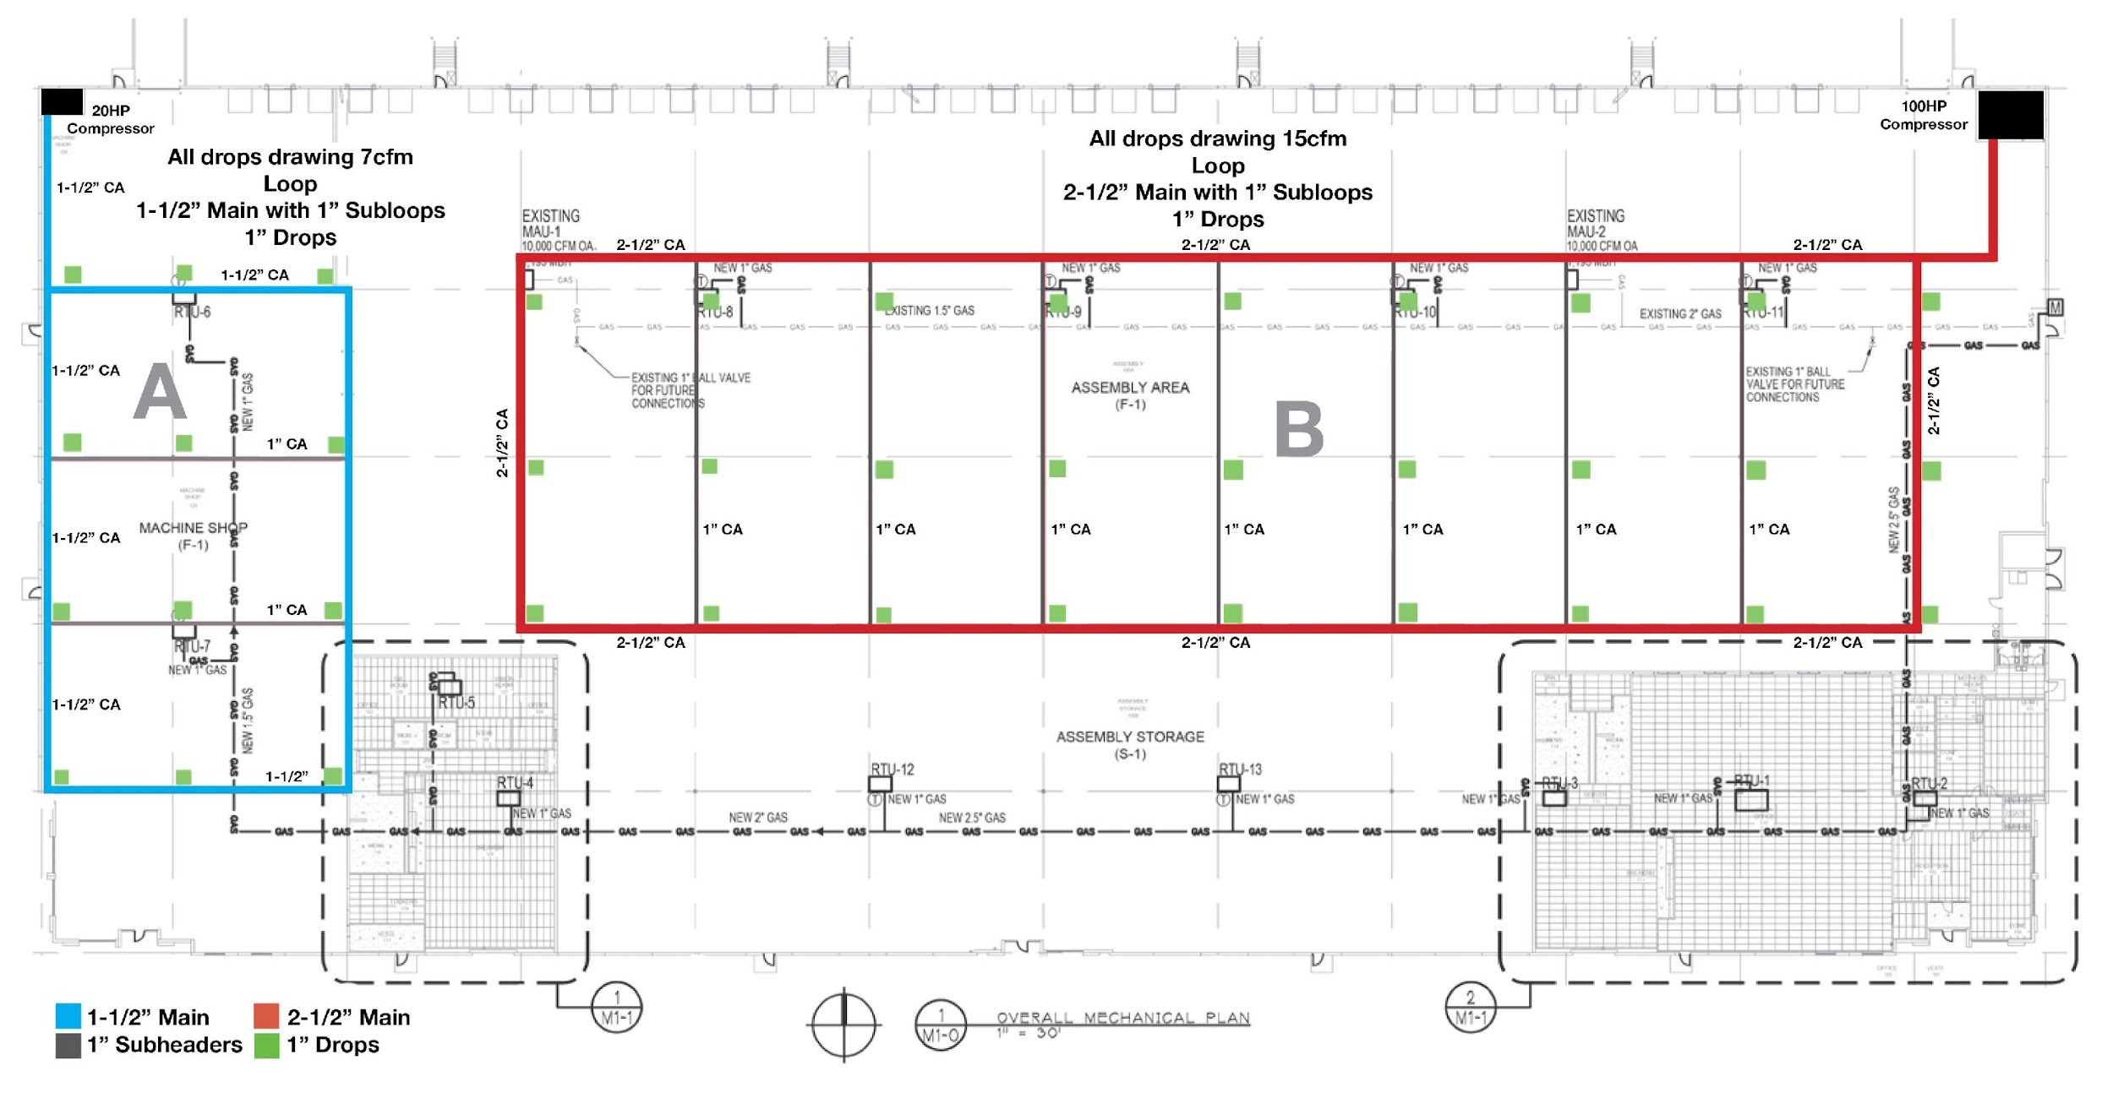
Right-Sized A - 1-1/2” Headers / 1” Sub-Loops / 1” Drops + Loop Layout
B - 2-1/2” Headers / 1” Sub-Loops / 1” Drops + Loop Layout
Two independent loop type systems
Almost ZERO PSID to any given point
Properly sized for each application
$8,200 over previous design
ROI = 1.4 years (24/7)
Installed Cost
Pipe & Fittings $36,000
Labor $15,600
Total Cost $51,600

Slide 47
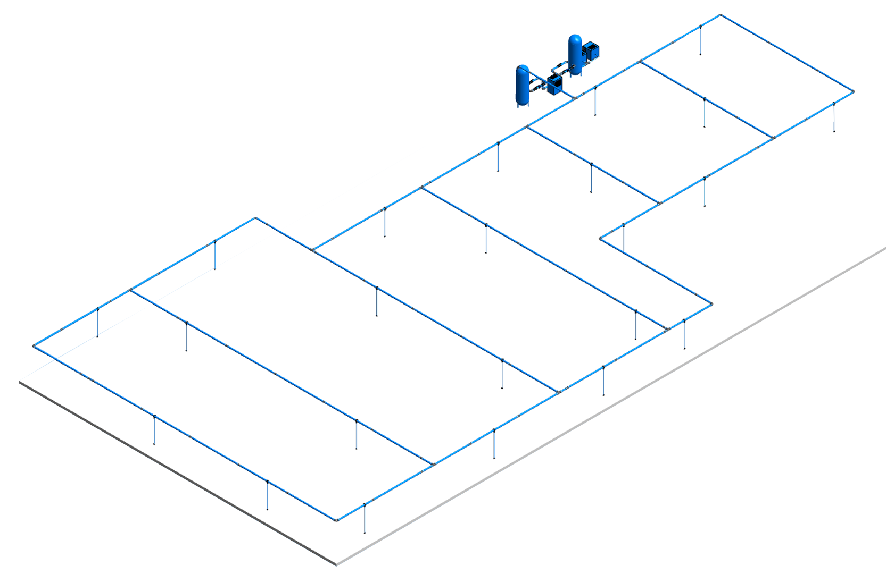
Right-Sized Piping Serves a Compressed Air System the Best
Properly designed compressed air systems have minimal pressure drop (not necesessarly 0 PSID) and allow for expansion if needed.
They are typically in a loop type configuration (exceptions apply)
They are centrally located so no drop is too far away from the main loop

Slide 48
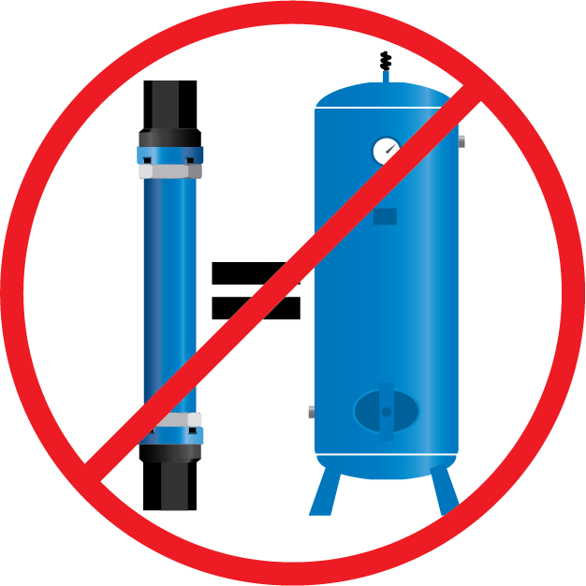
Over-Sized Piping is Wasteful and Misunderstood
Over-sized Piping is a problem that is ignored
Better than under-sized piping, but the value of over-sizing is misunderstood
The argument:
It acts like a storage tank
Better safe than sorry…
just go up a couple sizes
The tank discharge is 2” or 6” etc.

Slide 49
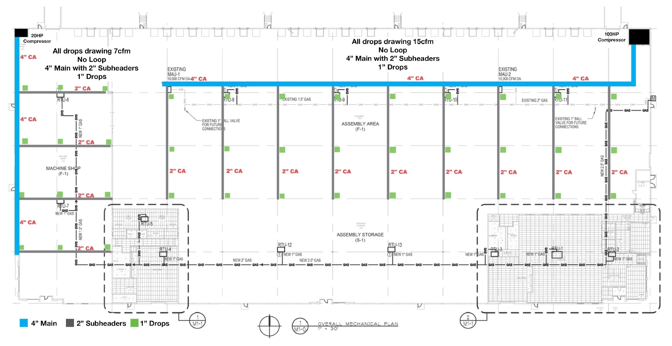
Commonly Over-Sized System 2” Headers / 1” Subheaders / 1”Drops + Dead End Layout
Not a Loop Type System
Piping is the same size although vastly different supply and demands
No PSID - GOOD
$14,500 Premium over properly designed loop system - Waste of nearly 25%
Installed Cost
Pipe & Fittings $46,900
Labor $19,200
Total Cost $66,100

Slide 50
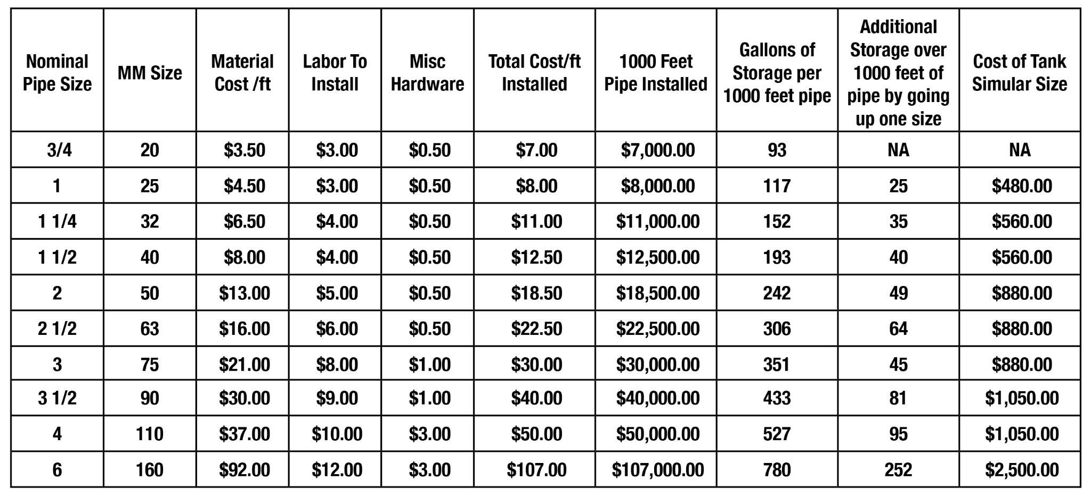
Over-Sized Piping for Storage is a Terrible Idea

Slide 51
The Reality of Using Over-Sized Pipe for Storage
A tank is much more cost effective
than over-sized piping
Larger pipe takes longer to install,
in some cases extending downtime,
adding to cost
Moisture and debris settle in low areas waiting for a surge of air to move them
(if they don’t become fixed)

Slide 52
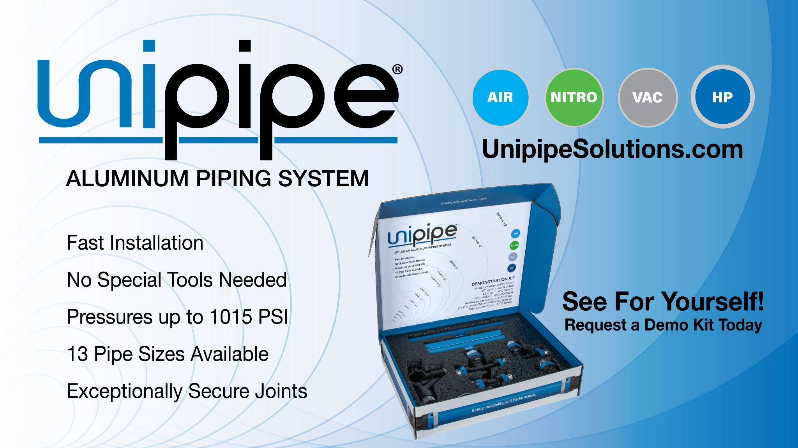

Slide 53
Compressed Air Piping Sizing & Design
Q&A
Please submit any questions through the Question Window on your GoToWebinar interface, directing them to Compressed Air Best Practices Magazine. Our panelists will do their best to address your questions and will follow up with you on anything that goes unanswered during this session.
Thank you for attending!
Sponsored by

Slide 54
Thank you for attending!
The recording and slides of this webinar will be made available to attendees via email later today.
PDH Certificates will be e-mailed to Attendees within 2 days.

Slide 55


March 2021 Webinar
On-site Nitrogen Generation Replacing Bulk Liquid Nitrogen
Sponsored by
Antonio Mayne, P.Eng.
Molson Coors Beverage Company
Keynote Speaker
Thursday, March 10, 2022 – 2:00 PM EST
Register for free at
www.airbestpractices.com/webinars

