Slide 1
Air Compressor Component Function, Troubleshooting & Maintenance
Loran Circle, Circle Training & Consulting
Keynote Speaker
Sponsored by
The recording and slides of this webinar will be made available to attendees via email later today.
PDH Certificates will be e-mailed to attendees within 2 days.

Slide 2
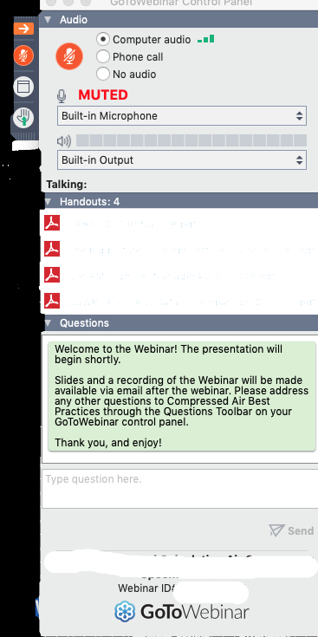
Q&A Format
Panelists will answer your questions during the Q&A session at the end of the Webinar.
Please post your questions in the Questions Window in your GoToWebinar interface.
Direct all questions to Compressed Air Best Practices® Magazine
Sponsored by

Slide 3
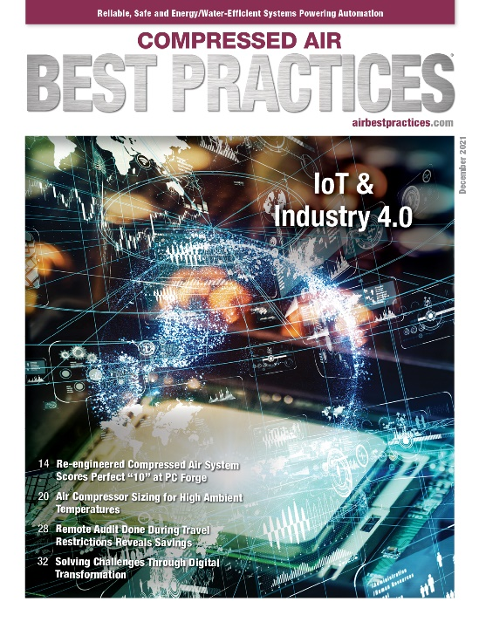
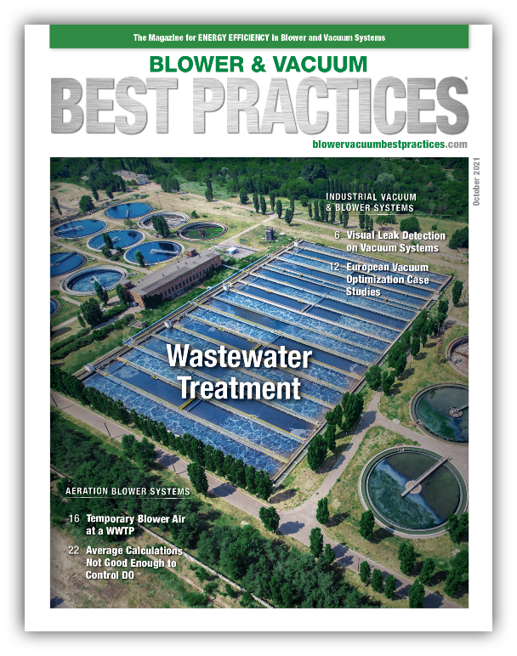
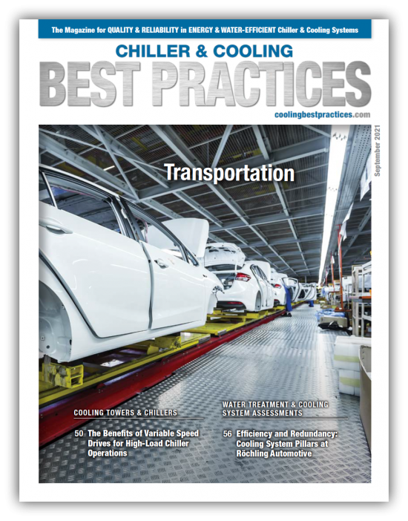
Handouts

Slide 4
Disclaimer
All rights are reserved. The contents of this publication may not be reproduced in whole or in part without consent of Smith Onandia Communications LLC. Smith Onandia Communications LLC does not assume and hereby disclaims any liability to any person for any loss or damage caused by errors or omissions in the material contained herein, regardless of whether such errors result from negligence, accident, or any other cause whatsoever.
All materials presented are educational. Each system is unique and must be evaluated on its own merits.

Slide 6
Air Compressor Component Function, Troubleshooting & Maintenance
Introduction by
Compressed Air Best Practices® Magazine
Sponsored by

Slide 7
About the Speaker
Compressed Air Systems Sales Training
Design and Consulting of Compressed Air Systems
Certified DOE AirMaster+
Loran Circle
Circle Training & Consulting
Sponsored by

Slide 8
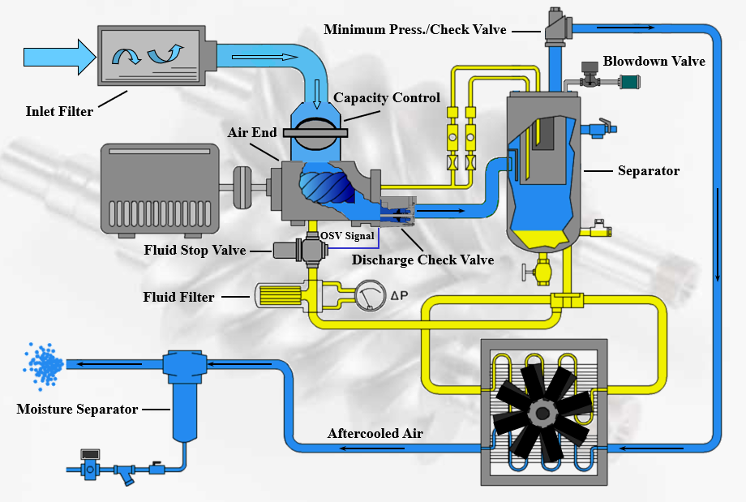
Five Components of an Air Compressor
Compression- Air End, rotors, stators, pistons, turbines, rotary vanes, etc.
Cooling - Coolers, air cooled, water cooled etc.
Drives - Motors, electric, diesel motors, steam driven etc.
Controls - Modulation, variable speed drives, variable capacity etc.
Electrical Systems – Power for controllers, solenoids, actuators, drives etc.

Slide 9
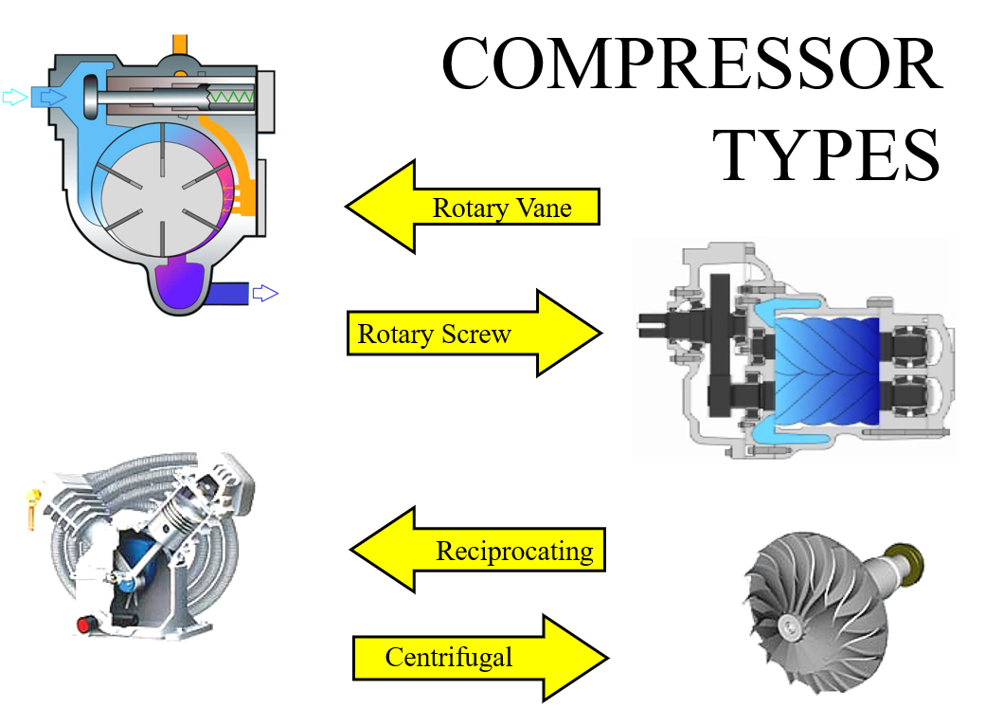
Air Compressor Units

Slide 10
Rotary Screw Air Compressor Components
The Air End of the compressor takes air in through the inlet filter under a VACUUM condition
The atmospheric air is mixed with a lubricant. This provides for cooling, sealing and lubrication
The compressed air/lubricant mixture leaves the air end and travels through the oil separator
The oil is separated and is circulated through the lubricant cooling system
The “clean” air is sent to the aftercooler for cooling to reduce moisture content. Once vapor is condensed to water, the moisture separator removes the water.
Note: If you are seeing visible moisture in your system, the issue could be the moisture separator

Slide 11
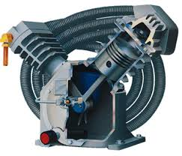
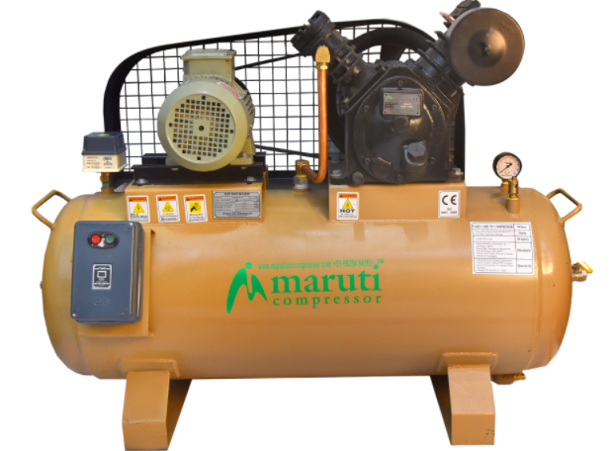
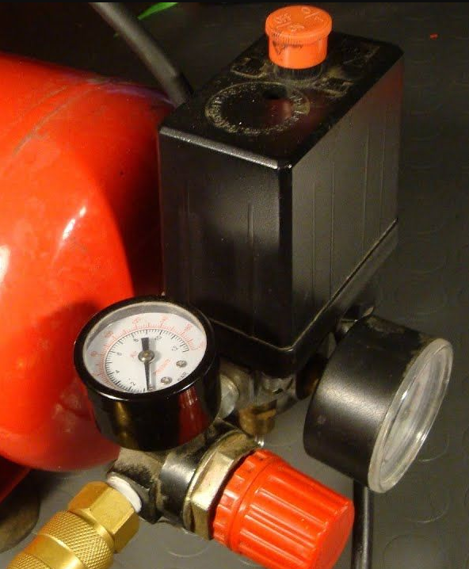
Reciprocating Air Compressor Components
Reciprocating compressors are the simplest compressors as far as their complexity
Either loaded or unloaded
Start/Stop
They also can be multiple stages depending on discharge pressure
Very few parts
Operates on an adjustable or fixed pressure range switch

Slide 12
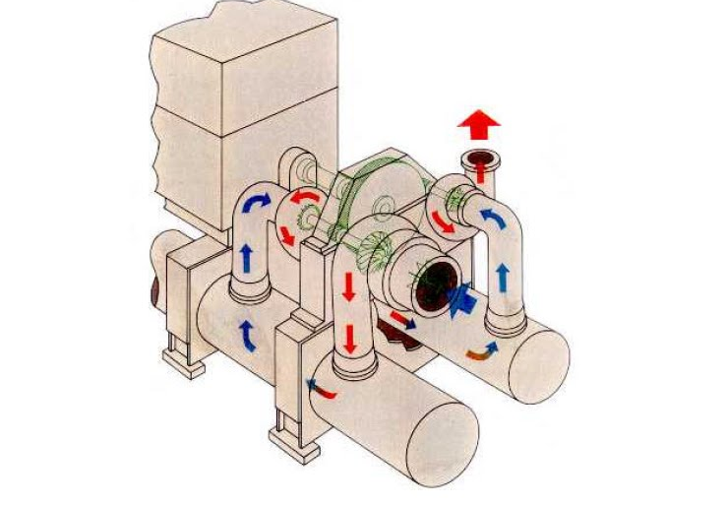
Centrifugal Air Compressor Components
Air End of the compressor takes air in through the inlet filter under a VACUUM condition
The atmospheric air is started spinning and enters the impeller

Slide 13
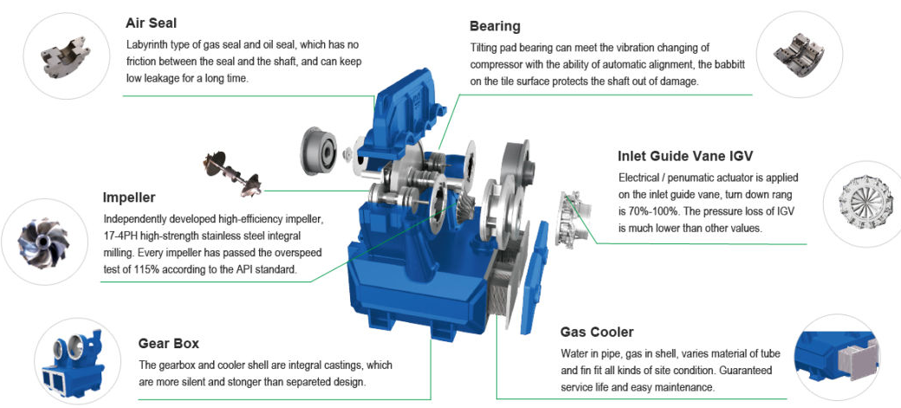
Centrifugal Air Compressor Components
In the first stage the air is compressed to “x” psig to start the compression to end with the desired discharge pressure. Centrifugal compressors are typically 2-4 stages, however desired discharge pressure is what determines the number of stages.
The air, after traveling through the different stages is sent to the aftercooler for cooling to reduce moisture content. Once vapor is condensed to water, the moisture separator removes the water.
*The next presentation will cover the different types of drying from the discharge of the aftercooler downstream.

Slide 14
Coolers
Usually there are two different coolers on the compressor
One is for air
One is for lubricant
Air to Air heat exchanger (fin/fan)
Water-cooled heat exchanger (tube and shell)
Air Cooled
Water cooled

Slide 15
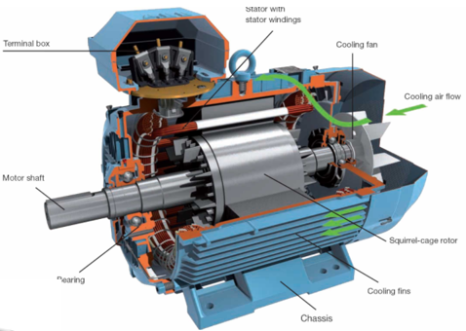
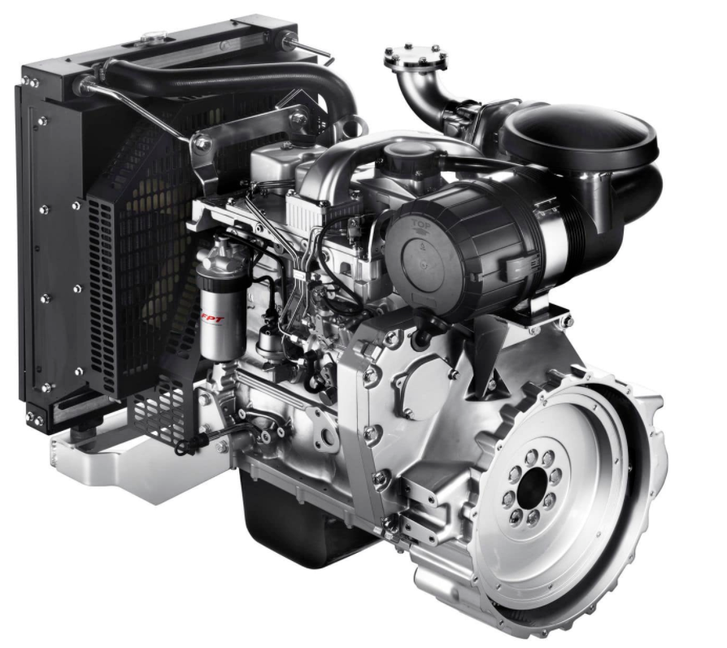
Air Compressor Drive Motors
DC Series Motor
Three phase Motor
Squirrel Cage Induction Motor
Synchronous Motor
Single phase Motor
Diesel Engine
Natural Gas
Steam Engine

Slide 16
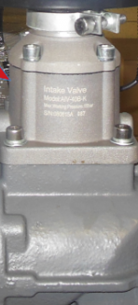
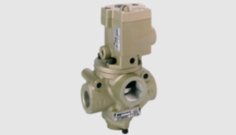
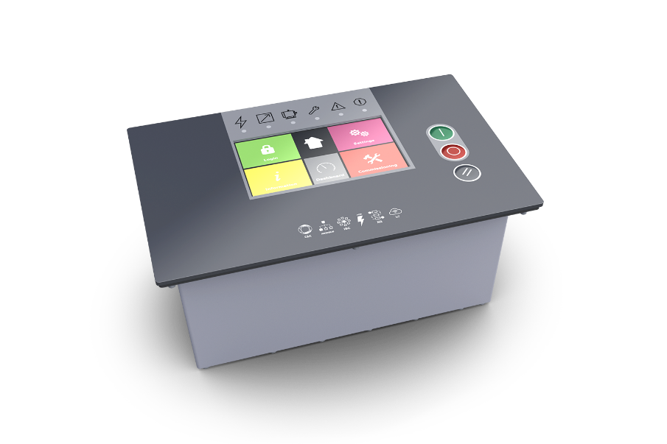
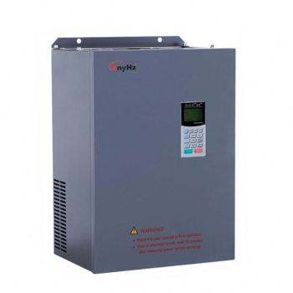
Air Compressor Controls
Pressure Switch
Load No/Load
Inlet Modulation
Variable Displacement
Variable Speed or Variable Frequency Drive

Slide 17
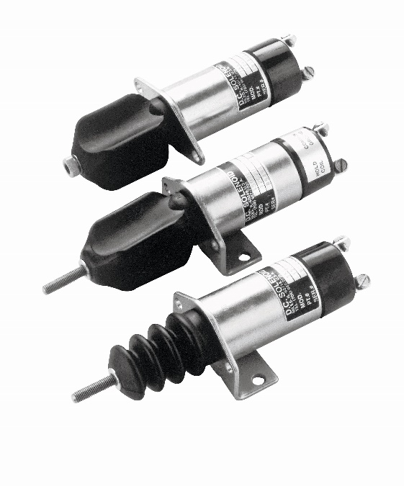
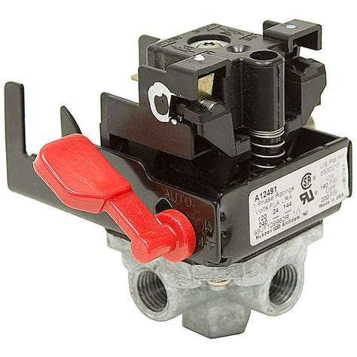
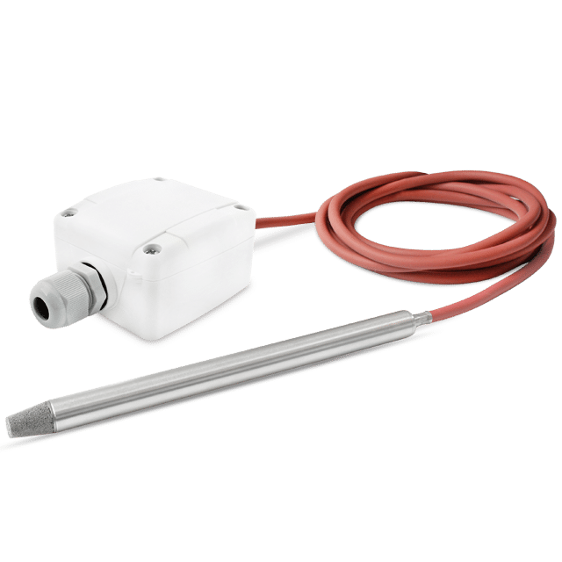
Electrical System
The electrical system provides power to the systems controls, which includes the controller, pressure switches, actuators etc.
Generally, there is a stepdown control transformer installed on the machine for voltage of various components.

Slide 18
Troubleshooting Common Problems
Discharge Air
Over Heating – Check with the manufacturer the amount of rise across a compressor and the temperature drop across a cooler. These will be the same
Inlet temperature of the machine doesn’t really affect the temperature of the machine
What it does effect is the temperature of the cooling air on an air-cooled machine.
With an infrared temperature gun shoot the inlet and outlet of the cooler
A plugged cooler from the outside will show a low temperature differential
What does a high temperature differential show?
190º
210º
Thermal Valve
Fluid Filter
180º
Legend
Atmosphere
High Pressure Air
Oil
Oil/Air Mixture
Aftercooled Air

Slide 19
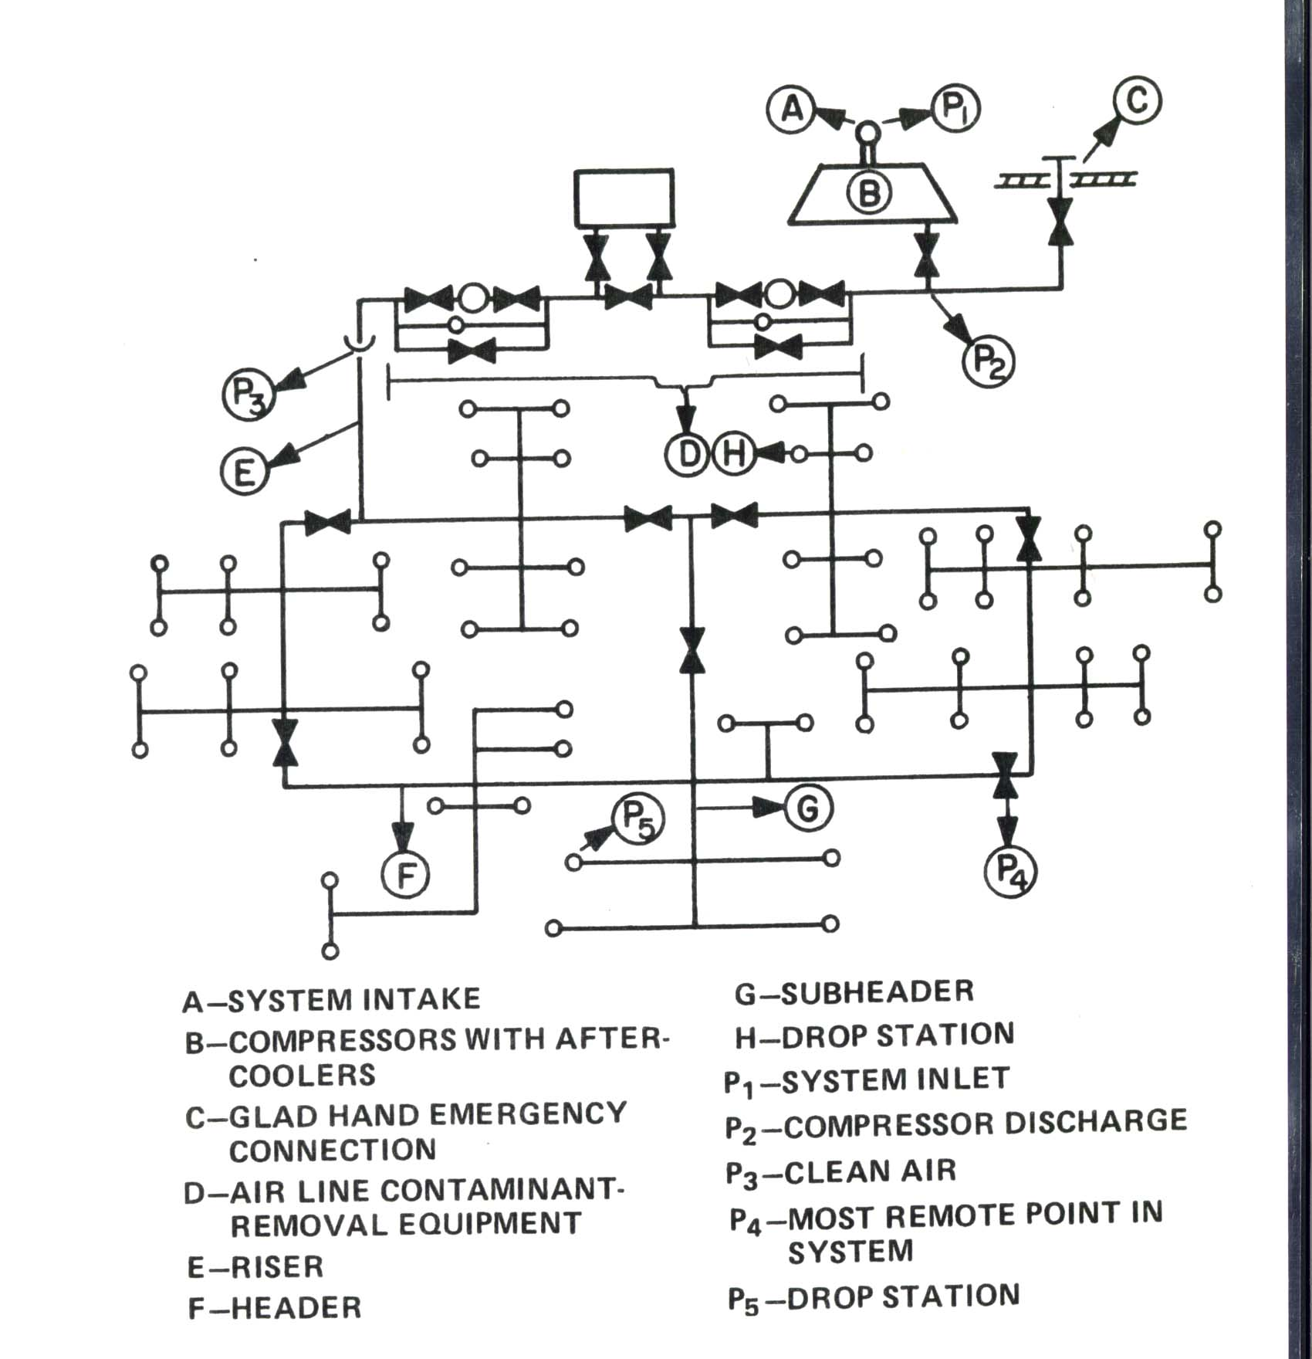
Trouble Shooting Pressure Problems
Check your pressure with a pressure gauge at the end of the system.
A large pressure differential shows a flow restriction
Check pressure differential across filters
Check areas of distribution system for piping losses
80 PSIG
120 PSIG
70 PSIG

Slide 20
Pressure Problems (cont’d.)
Pressure at the discharge is 90 PSIG
Pressure at the end of the line is 80 PSIG
This is an overdemand situation
The demand is exceeding the compressor capacity
There are only two reasons for pressure drop
Either flow restriction or overdemand
85 PSIG
90 PSIG
80 PSIG

Slide 21
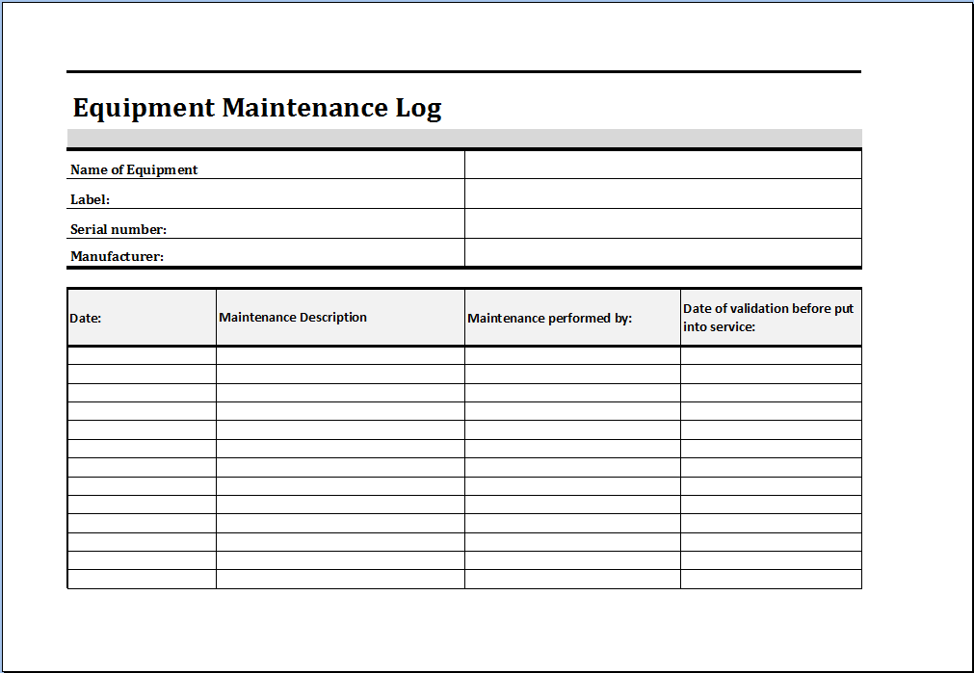
Maintainence
Set up a regular visual inspection program
Keep logs for equipment maintenance, temperature and pressure readings
Change your filters upon manufacturers recommendations
Use OEM parts

Slide 22
Air Compressor Component Function, Troubleshooting & Maintenance
Thank You For Attending
Loran Circle Compressed Air Systems Consulting and Training Poland, Ohio 44514 832-906-0469

Slide 23
About the Speaker
Technical Service Specialist, BEKO Technologies
7 years in the Compressed Air industry
Jaime Munera
BEKO Technologies
Sponsored by

Slide 24
Compressed Air Equipment Maintenance
Tips for Compressed Air System Maintenance
Speaker: Jaime Munera

Slide 25
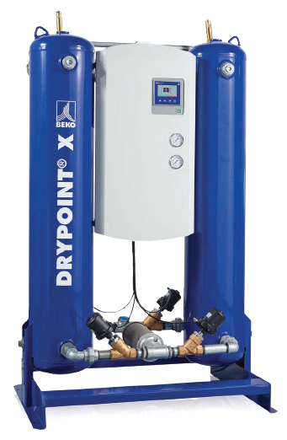
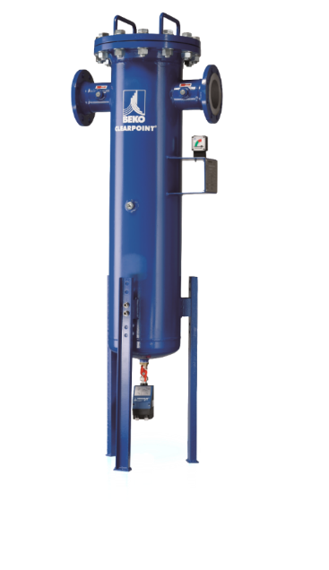
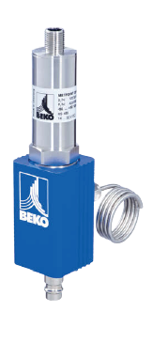
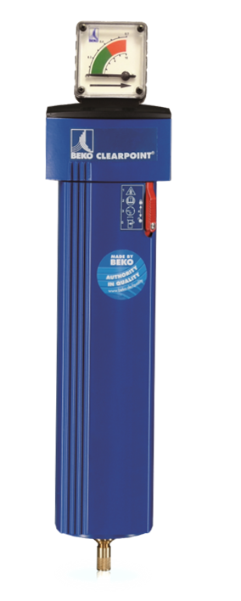
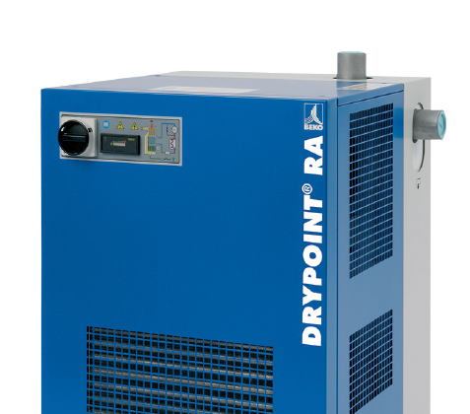
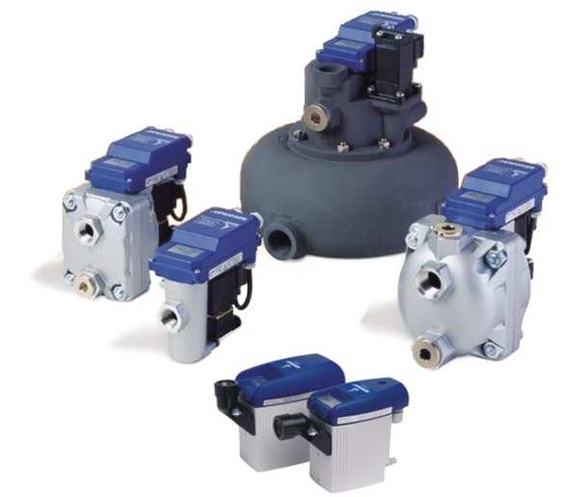
Compressed Air Treatment – Products We Will Discuss For Maintenance
CLEARPOINT Filtration
DPX Desiccant Dryers
METPOINT Sensors
IMPORTANT:
Please note that the information contained in this document is general maintenance/installation guidance. Always refer to your product manual on the specific model for detailed installation, operation and maintenance information for any piece of equipment.
RA Refrigerated Dryers
BEKOMAT Condensate Drains

Slide 26
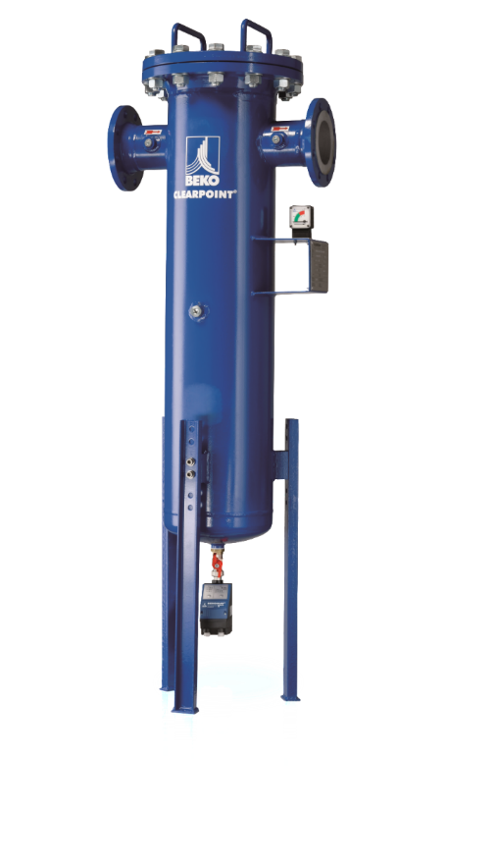
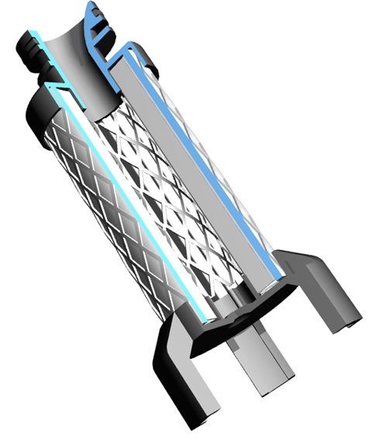
Compressed Air Treatment - Filtration
Equipment Types
Flanged -Threaded
Maintenance
Filter Element
Drain Cartridge
Maintenance Intervals
8,000 Hours

Slide 27
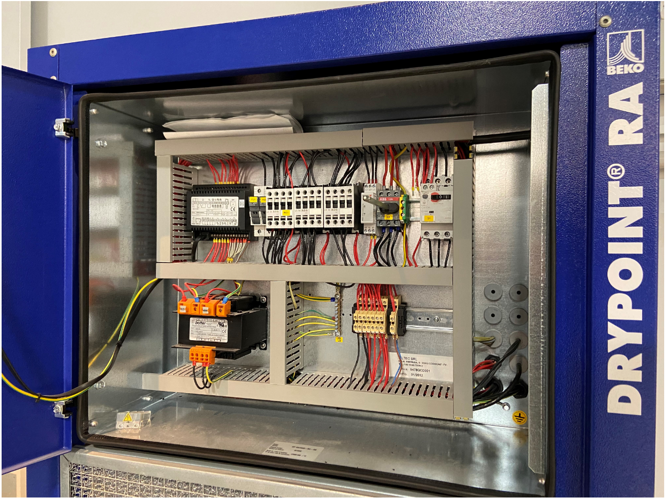
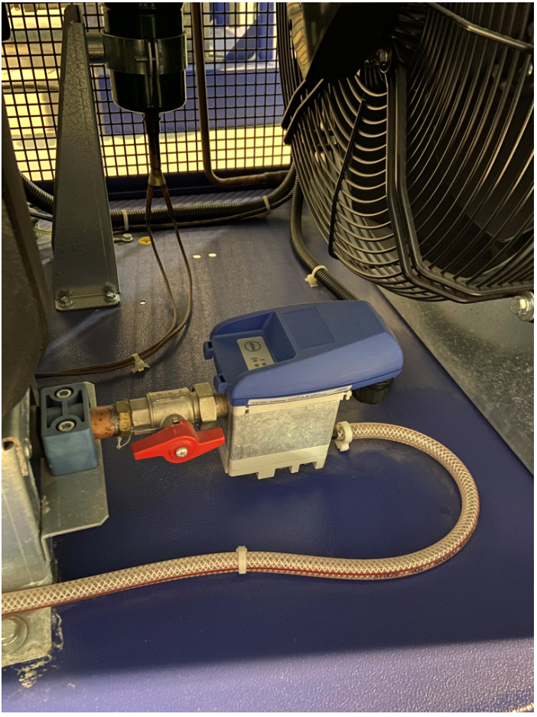
Compressed Air Treatment - Refrigerated Dryers
Refrigerated Dryers – Commonly Used
38 F (3 C) Dew Point
Dryer
Drypoint RA Refrigerated
Maintenance
Condensers Cleaning
Drain Maintenance
Electrical Connection Checks
Visual Inspection
Maintenance Intervals
8,000 Hours

Slide 28
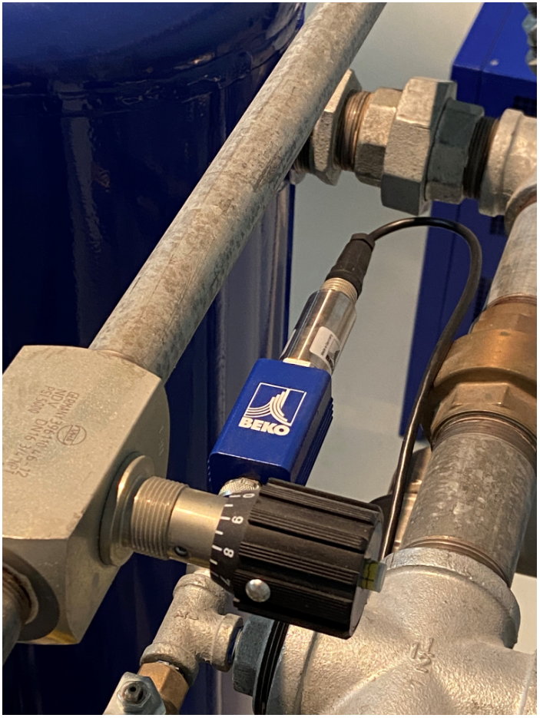
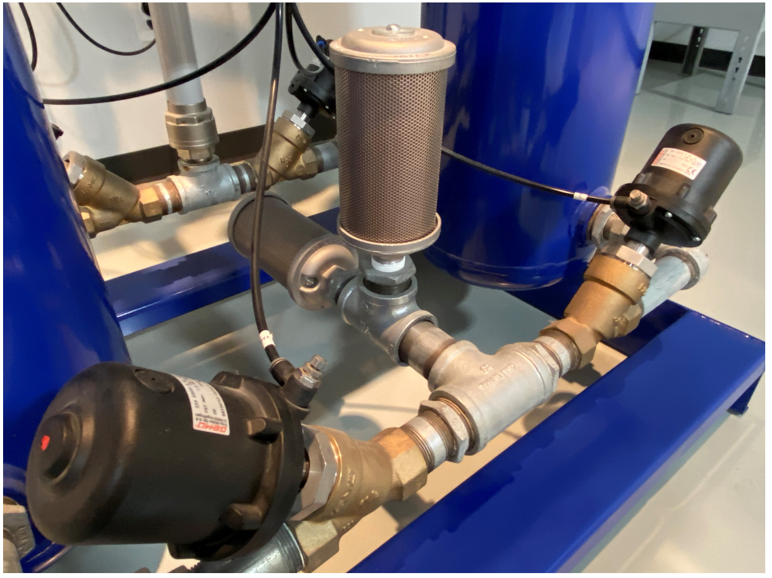
Compressed Air Treatment - Desiccant Dryers
Dryer
XCE XCP ACC
Dryer Maintenance
Pre-/Post Filtration
Silencers/Mufflers
Dew Point Sensors
Valve Service
Safety Checks
Maintenance Intervals
8,000 Hours
16,000 Hours
24,000 Hours
Dew Points from
-4 F (-20 C) to -100 F (-73 C)

Slide 29
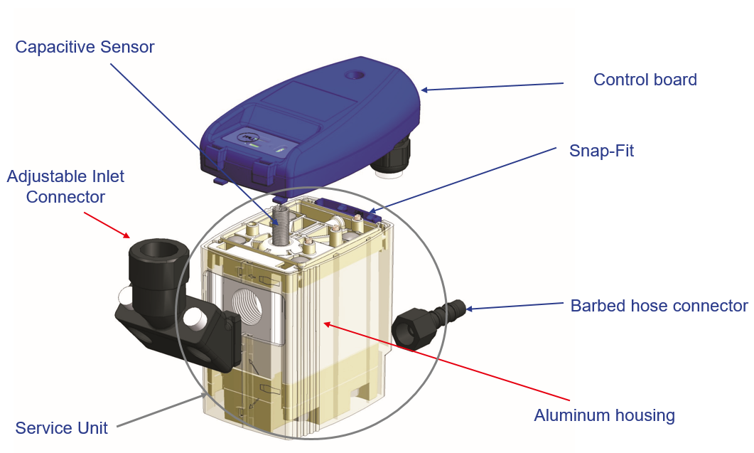
Compressed Air Treatment - Zero Loss Drain
Drain Types
BEKO 31,32 and 32 VERIO
Maintenance
Drain Cartridge/Service Unit
Check Connections
Maintenance Intervals
8,000 Hours/1 Million Cycles

Slide 30
BEKOMAT 13, 14, 16
Drain Types
Higher volume/ Pressure units
Maintenance
Break down, clean and Reassemble with service kit
Check and verify connections
Maintenance Intervals
8,000 hours/ 1Million Cycles

Slide 31
Compressed Air Treatment – Instrumentation Sensors
SP
Pressure Meter
Sensor Types
Flow/Pressure/Dew Point
Maintenance
Inspection/Calibration
Connections & Fittings
Maintenance Intervals
Yearly
DPM
Dew Point Meter
FLM
Flow Meter

Slide 32
To Conclude
Thank You!
BEKO TECHNOLOGIES, CORP. 900 Great SW Parkway SW Atlanta, GA 30336 UNITED STATES +1 (800) 235-6797 www.bekousa.com
Sales Contact Information: https://www.beko-technologies.us/en-us/contact

Slide 33
Air Compressor Component Function, Troubleshooting & Maintenance
Q&A
Please submit any questions through the Question Window on your GoToWebinar interface, directing them to Compressed Air Best Practices Magazine. Our panelists will do their best to address your questions and will follow up with you on anything that goes unanswered during this session.
Thank you for attending!
Sponsored by

Slide 34
Thank you for attending!
The recording and slides of this webinar will be made available to attendees via email later today.
PDH Certificates will be e-mailed to Attendees within 2 days.

Slide 35
February 2021 Webinar Compressed Air Piping System Sizing & Design
Sponsored by
Tim Dugan, P.E.
Compression Engineering Corporation
Keynote Speaker
Thursday, February 17, 2022 – 2:00 PM EST
Register for free at
www.airbestpractices.com/webinars

