Slide 1
VSD Air Compressor Installation Guidelines
Loran Circle, Circle Training & Consulting
Keynote Speaker
The recording and slides of this webinar will be made available to attendees via email later today.
PDH Certificates will be e-mailed to attendees within two days.

Slide 2
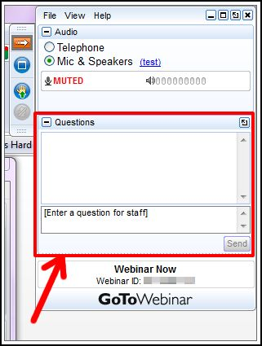
Q&A Format
Panelists will answer your questions during the Q&A session at the end of the Webinar.
Please post your questions in the Questions Window in your GoToWebinar interface.
Direct all questions to Compressed Air Best Practices® Magazine

Slide 3
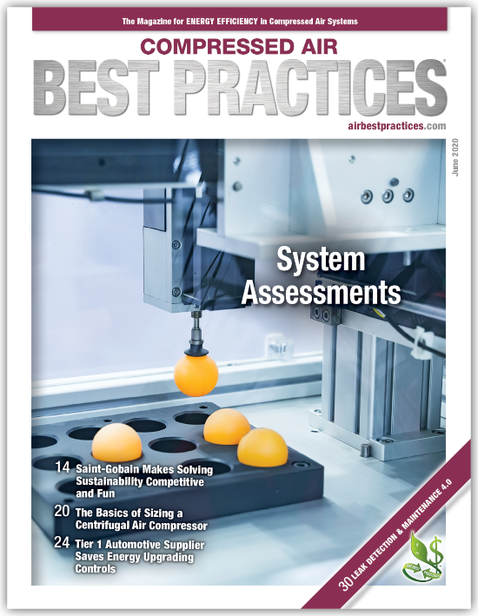
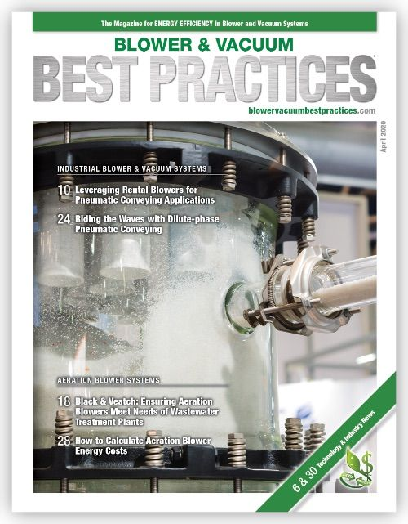
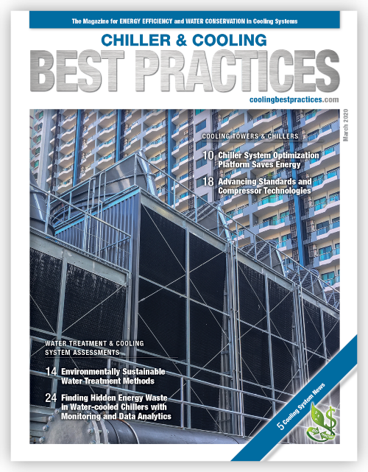
Handouts

Slide 4
Disclaimer
All rights are reserved. The contents of this publication may not be reproduced in whole or in part without consent of Smith Onandia Communications LLC. Smith Onandia Communications LLC does not assume and hereby disclaims any liability to any person for any loss or damage caused by errors or omissions in the material contained herein, regardless of whether such errors result from negligence, accident, or any other cause whatsoever.
All materials presented are educational. Each system is unique and must be evaluated on its own merits.

Slide 5
Best Practices 2020 Goes ONLINE!

Slide 6
VSD Air Compressor Installation Guidelines
Introduction
Compressed Air Best Practices® Magazine

Slide 7
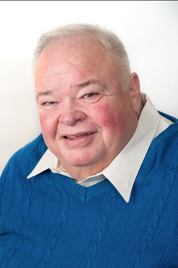
About the Speaker
Senior Consultant, Circle Training & Consulting
Over 45 years of experience in the compressed air industry
Certified AirMaster Plus by Department of Energy
Loran Circle
Circle Training & Consulting

Slide 8
VSD Air Compressor Installation Guidelines
June 18, 2020
Loran Circle

Slide 9
Webinar Content
We will cover:
VSD proper sizing and location
We will review VSD maintenance
Proper installation
Electrical requirements
Remote mounting
VSD environmental considerations.

Slide 10
VFD vs. VSD
We frequently hear the term VFD and VSD. What is the difference?
VFD stands for Variable Frequency Drive
VSD stands for Variable Speed Drive
They are both the same thing
A drive is changing the frequency to adjust the speed of the motor. Therefore we end up with the Variable Frequency resulting in Variable Speed of the motor
For this presentation we will use the term Variable Speed Drive to refer to the drive.

Slide 11
Safety
* Disclaimer
The following presentation is designed as an overview of VSD sizing, maintenance, installation and operation.
It does incorporate best practices
The content in no way should supersede or replace the compressor or drive manufacturer's recommendations or instructions.
Presentation charts are for reference only
Please refer to the manufacturer's manual for all safety procedures
Be aware of local codes

Slide 12
Why A VSD?
Can I benefit from a VSD?
Why are VSD’s more efficient than Fixed Speed Compressors?
Inlet modulation controls respond to demand by “throttling” the inlet of the compressor and reducing the inlet pressure thereby increasing compression ratios
Load/No Load controls operate with inlet open or closed and bring air in at atmospheric pressure. Compression ratios at full load are efficient. Receiver volume directly affects the reduction of energy required, due to blowdown and load cycles.
VSD’s operate with inlet open through turndown range keeping compression ratios optimized.

Slide 13
Getting Started
Why do I need a VSD Compressor?
Determining factors for a VSD
VSD proper sizing and location
VSD in MOST case must be larger than the fixed speed machine
VSD maintenance, installation, electrical requirements, and remote mounting. We will also discuss VSD environmental considerations.
Why when applied to air compressors why they are more efficient than other types of controls.
How to optimize operating costs by lowering pressure on a VSD.
Importance of site conditions and location of drive environment.
Optimizing compressor efficiency using a VSD.
How are leak costs affected by a VSD?
Optimizing VSD’s with proper maintenance.

Slide 14
The Factors
Site Conditions
Application
Demand Profile
After this review….

Slide 15
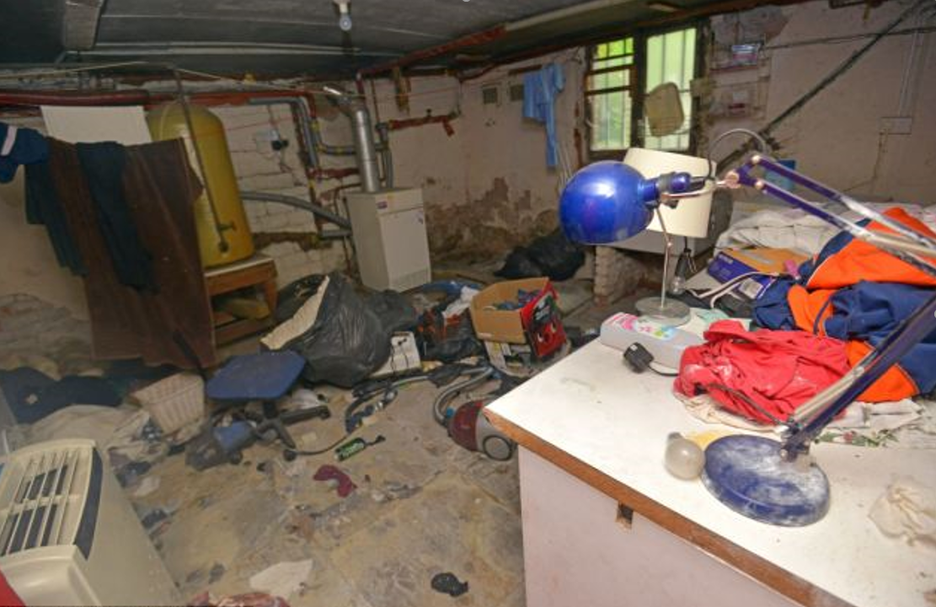
We Have Just The Perfect Place
And we already have a tank!!!

Slide 16
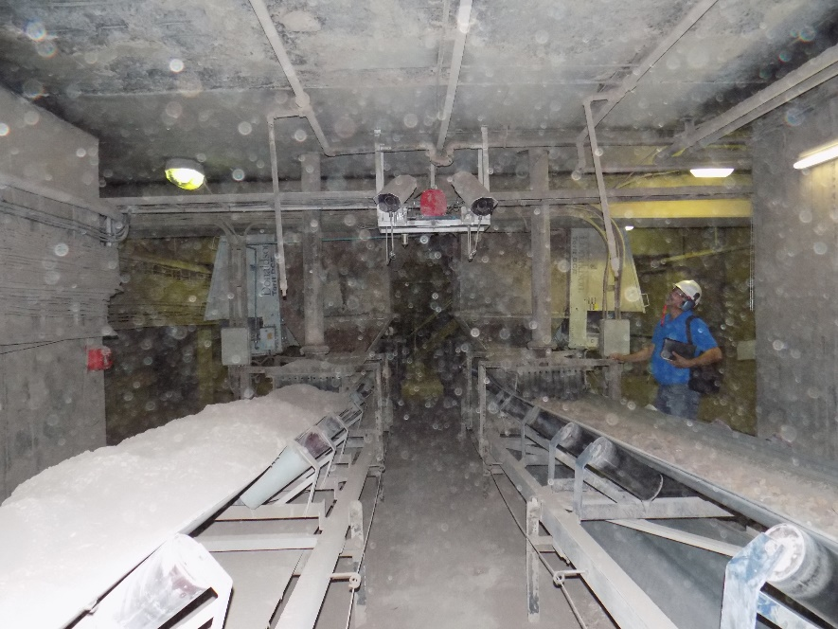
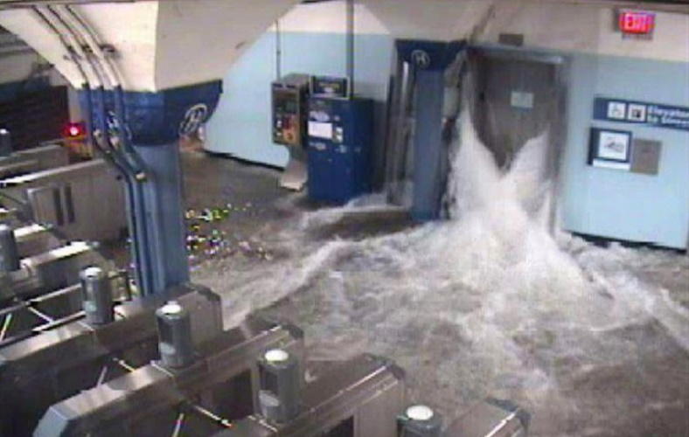
Site Conditions and Installation
A VSD is a computer.
If you would not feel comfortable placing a desktop computer case in your VSD compressor location, find a different location or explore the possibility of remotely mounting drive.
Pay attention to high and low ambient temperature ranges at the installation.
Temperature swings can cause condensate to form inside of drive.
Dust can cause build up of static electricity.
Keep out of damp areas
If the drive is remotely mounted follow manufactures instructions on limiting cable lengths.
Do not place control wires in same conduit or run along side of the machine's electrical conduit.
If you have to cross control and electrical wires do so at a 90-degree angle to avoid distortion.

Slide 17
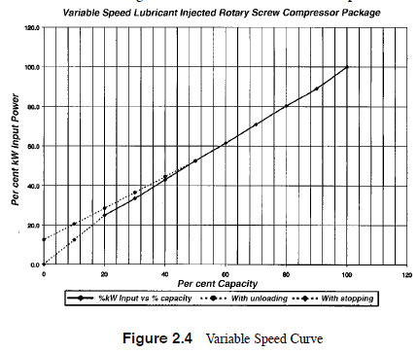
Sizing For Demand Profile
In general operating range of 40-80% is optimal
You should not use VSD as full load base machines. The power usage would be typically 100% full load + 3% for the drive
Is the VSD going to be the only machine operating or will it be in a system with base load machines?
How will they be controlled?
Are there two VSD’s in the system?
How will they be controlled?

Slide 18
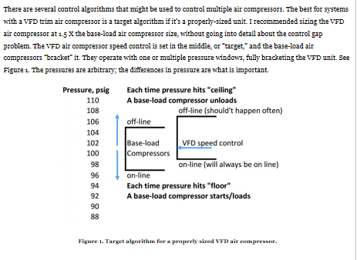
Setting Controls

Slide 19
Sizing A VSD
https://www.airbestpractices.com/technology/air-compressors/how-avoid-control-gap-vfd-rotary-screw-air-compressors
By Tim Dugan
https://www.airbestpractices.com/technology/compressor-controls/air-compressor-control-gap-issues-solved-ethanol-plant
https://www.airbestpractices.com/technology/compressor-controls/vsd-compressor-control
Both by Ron Marshall

Slide 20
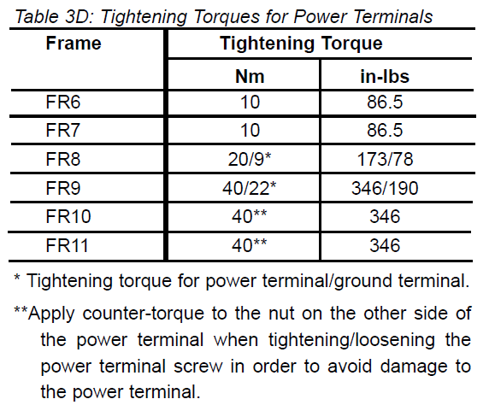
Installation
Before starting the installation, check that none of the compressor components or the VSD are live.
Place the motor conductors sufficiently far from other conductors
Avoid placing the motor conductors in long parallel lines with other conductors.
The motor conductors should cross other at an angle of 90 degrees
Verify manufacturers recommended tightening torque values for lugs
For SAMPLE reference only. Refer to your manufacturer's recommendations

Slide 21
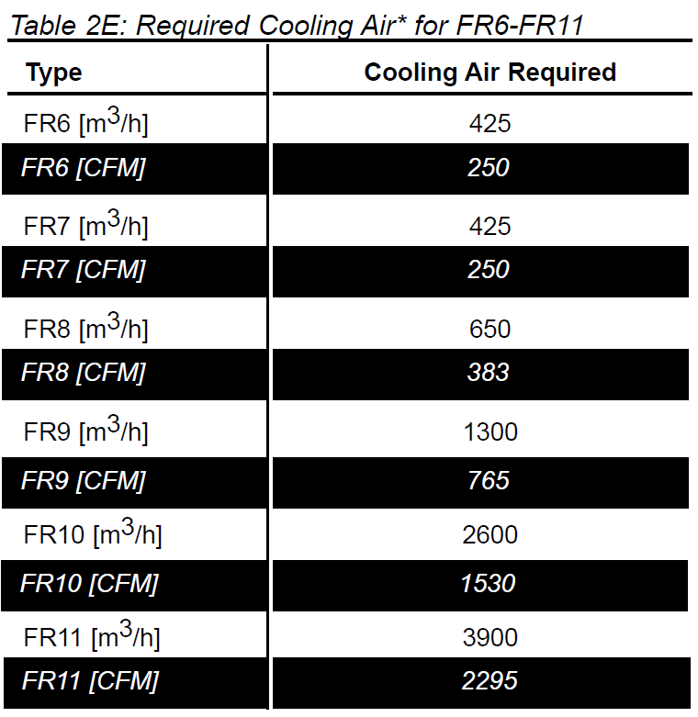
Do’s
Pick an area of the plant that is clean
Pick an area that the temperature range is between the manufacturers recommended standards
Pick a dry area free from dust oil and aerosols
Allow enough free space around the unit for suitable cooling

Slide 22
Sample Manufacturers Recommendations

Slide 23
Electrical Requirements
The table to the right is to be used as a reference only
Make sure to have proper cable sizing
When using an electrical contractor, have them size and design the wiring and disconnect
Utilize a fast acting disconnect
Make sure that (if needed) harmonic distortion filtration is provided

Slide 24
Installation Of Receivers
Allows for capacitance of system to dampen pulsation.
Unload and load setpoints are critical in determining storage capacity
Storage helps with dampening startup of a base load or backup machine.
Refer to manufacturer and more importantly the application of the machine and demand profile for proper sizing.
Flattens the curve

Slide 25
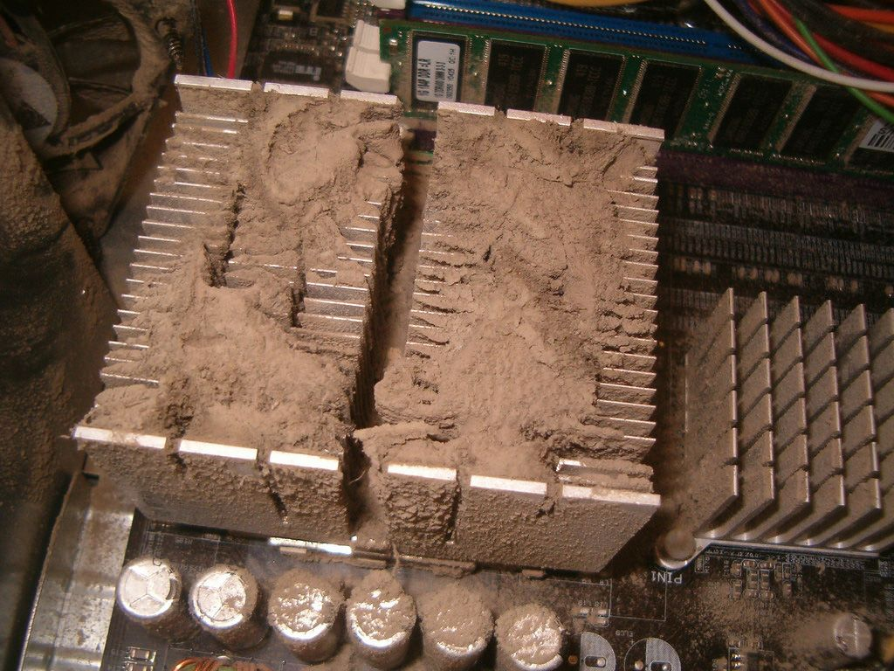
Importance Of Maintenance
Drive Maintenance is the most important tip in Optimizing VSD’s and is the most neglected.
Uptime of VSD compressor is vital to manufacturing plants
One to 7 days of downtime on a drive can eliminate a year of more of energy savings Plant downtime and loss of a VSD compressor in a plant can wipe out days, months or years of energy savings
Keep dust and dirt out of machine

Slide 26
Recommended Maintenance Procedures
*Please note these are suggested please refer to drive operation and maintenance manual

Slide 27
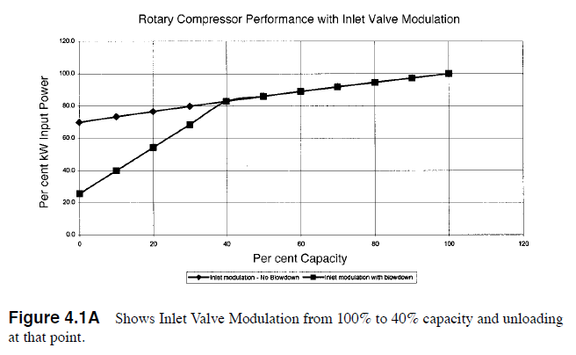
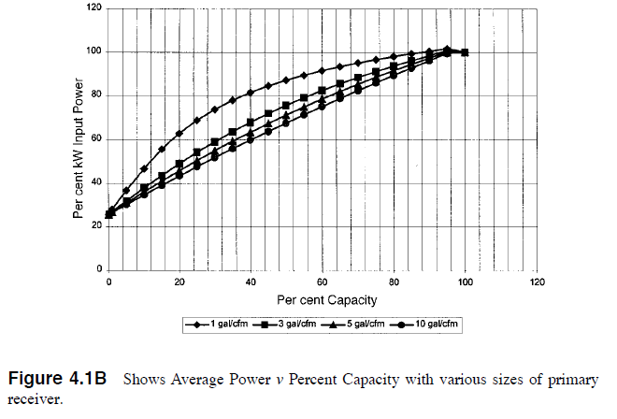
VSD And Leaks
Maximize efficiency by reducing to the lowest plant needed pressure.
Before placing a VSD in service analyze existing system, site conditions, application and demand profile.
Make sure that control gap is considered and that the VSD machine is used in trim and fixed speeds machines are used in base load.
Optimize savings by fixing leaks
Do regular maintenance and inspections of the VSD for any issues.
A properly maintained drive can last for 20 years or more. Keep your plant running in optimal order by have a regular PM for the VSD.

Slide 28
Maximizing Your Savings
Use the “lowering the river” approach to setting up plant pressure
Make sure your drive is being used in the trim mode.
Make sure that base load fixed speed machines controls are set properly
VSD machine mu
Load/ unload delta P should be double ancillary (dryer, filters etc.) equipment pressure drop
Utilize the “call and scream lines” in your plant and set pressure + 3 PSIG above minimum level

Slide 29
Retrofitting Of VSD On Older Compressors
Many times I have come across customers who have lost a drive on a compressor.
Many times they want to replace the VSD with a FV (full voltage), wye or star delta, or solid-state RV (reduced voltage) starter.
Many times they have already done it themselves
What happens?
Manufacturer has either a gear set or L/D profile that is designed to run over a hz range most times exceeding 60hz. Changing starter creates a fixed speed machine with the capacity matched to that of the air end output at that speed.

Slide 30
Controls Summary
VSD Compressors should have 20-50% more flow than the next sized machine
Utilize storage in the system to compensate for response time of VSD and fixed speed machines.
Pressure set points are at least double the PD across the dryer.
Using a VSD machine as a backup.
Depends on how the VFD’s are controlled
Refer to mentioned articles in Compressed Air Best Practices publication
Most importantly, make sure that control setpoints are adjusted properly!

Slide 31
Installation Summary
Follow manufacturers recommended installation procedures
Use qualified electrical contractors
Let them design the installation
Electrical codes vary from municipality to municipality
And from state to state

Slide 32
VSD Air Compressor Installation Guidelines
Q&A
Please submit any questions through the Question Window on your GoToWebinar interface, directing them to Compressed Air Best Practices Magazine. Our panelists will do their best to address your questions and will follow up with you on anything that goes unanswered during this session.
Thank you for attending!

Slide 33
Thank you for attending!
The recording and slides of this webinar will be made available to attendees via email later today.
PDH Certificates will be e-mailed to Attendees within two days.

Slide 34
July Webinar Where Does Blower Air Go? Process Fundamentals
Tom Jenkins
Keynote Speaker
JenTech, Inc.
Thursday, July 20, 2020 – 2:00 PM EST
Register for free at
www.airbestpractices.com/magazine/webinars

